Slide 1

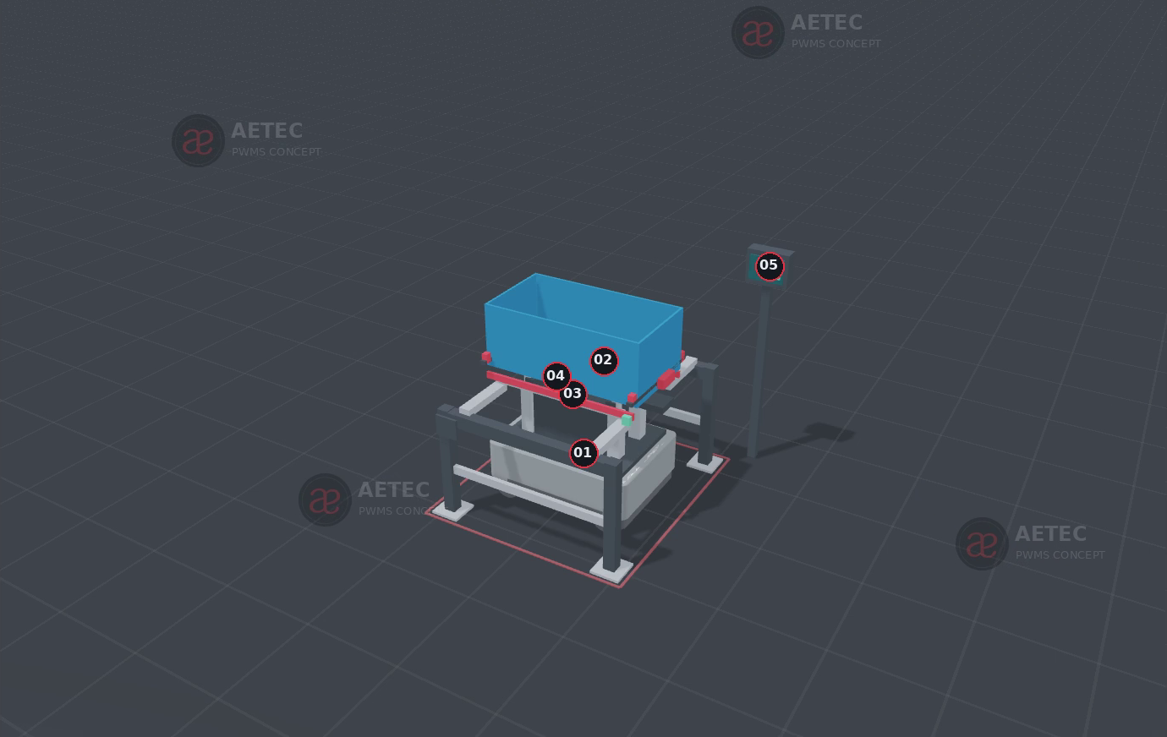
AETEC / PWMS ENGINEERING DECISION STUDY
Container strategy and AMR investment
One common box.
Five handling options.
35 kg raw part
17 process stations
Full system cost comparison
Prepared for Marshawn and the PWMS team
Lim Yee Wei, Aetec
MiR250 box-jack concept. Geometry to be redesigned for the unified container.
Discussion study. Equipment selection, container dimensions and site layout remain open.
AETEC / Lim Yee Wei / Rev 15 / 14 Oct 2026 / Discussion estimate, SGD excl. GST
01
Notes:
Sources: customer AETEC - ASRS and AMR Mapping R1.xlsx, Marshawn email 13 July 2026; PWMS MiR Hook Phase1 Option1 Proposal Rev3; End-to-End ASRS AMR Options Budgetary Quotation Rev6 (5 September 2026, expired); Five AMR Methods Budgetary Supplement Rev7 (14 September 2026). Raw part 35 kg confirmed by current user instruction, 13 October 2026. All new rates and geometry assumptions are engineering scenarios, not supplier quotations.
Rev14 graphical explanation: Financial inputs remain the Rev13 discussion model. Company logo copied unchanged from Aetec Company Profile v8. Red/black/grey client-deck furniture retained. Concepts need mechanical qualification.

Slide 2
PWMS / CONTAINER STRATEGY
Four design decisions change the whole system
01
02
03
04
Container
Presentation
Transfer
Storage
Small FG box or a
raw-compatible rigid base
A travelling trolley or
a local ergonomic dock
Hook, guided jack
or powered conveyor
Box pitch, load rating
and the ASRS envelope
The same box can simplify tracking while increasing storage pitch.
PWMS must decide how much capital, floor area and process change each benefit justifies.
AETEC / Lim Yee Wei / Rev 15 / 14 Oct 2026 / Discussion estimate, SGD excl. GST
02
Notes:
Sources: customer AETEC - ASRS and AMR Mapping R1.xlsx, Marshawn email 13 July 2026; PWMS MiR Hook Phase1 Option1 Proposal Rev3; End-to-End ASRS AMR Options Budgetary Quotation Rev6 (5 September 2026, expired); Five AMR Methods Budgetary Supplement Rev7 (14 September 2026). Raw part 35 kg confirmed by current user instruction, 13 October 2026. All new rates and geometry assumptions are engineering scenarios, not supplier quotations.
Rev14 graphical explanation: Financial inputs remain the Rev13 discussion model. Company logo copied unchanged from Aetec Company Profile v8. Red/black/grey client-deck furniture retained. Concepts need mechanical qualification.

Slide 3
PWMS / CONTAINER STRATEGY
Confirmed facts and open assumptions
Item | Current basis | Status
Raw part mass | 35 kg | Customer instruction; supersedes old mass
Process stations | 17, including CMM Root at 12 | Verified against customer mapping
Final inspection | Station 15; then 16 and 17 | Box introduction after PASS is current basis
FG box fit | Raw part does not fit current FG box | Customer instruction
Unified box envelope | 1,400 × 700 × 450 mm external | Illustrative only; internal fit unverified
Volume / operating time | 40 parts/day; 24 hours/day | Prior 35–40/day basis; confirm current demand
Incoming/outgoing are separate nodes. Nineteen nodes does not mean nineteen production processes.
AETEC / Lim Yee Wei / Rev 15 / 14 Oct 2026 / Discussion estimate, SGD excl. GST
03
Notes:
Sources: customer AETEC - ASRS and AMR Mapping R1.xlsx, Marshawn email 13 July 2026; PWMS MiR Hook Phase1 Option1 Proposal Rev3; End-to-End ASRS AMR Options Budgetary Quotation Rev6 (5 September 2026, expired); Five AMR Methods Budgetary Supplement Rev7 (14 September 2026). Raw part 35 kg confirmed by current user instruction, 13 October 2026. All new rates and geometry assumptions are engineering scenarios, not supplier quotations.
Rev14 graphical explanation: Financial inputs remain the Rev13 discussion model. Company logo copied unchanged from Aetec Company Profile v8. Red/black/grey client-deck furniture retained. Concepts need mechanical qualification.

Slide 4
PWMS / CONTAINER STRATEGY
The customer route contains 17 processes
Incoming store
01–06
01
Root Mill
02
Airfoil Mill
03
FPI
04
Polishing
05
Vibro
06
Wash
07
Detail Inspection
08
Shot Peen
09
Tip Mill
10
Blend Tip
11
FPI Tip
12
CMM Root
13
GOM
14
Wash
15
Final Inspection
16
Over Inspection
17
Packing
FG ASRS
Outgoing
Continue 06 to 07, then 12 to 13
Current trolley route: incoming through process 15
AETEC / Lim Yee Wei / Rev 15 / 14 Oct 2026 / Discussion estimate, SGD excl. GST
04
Notes:
Sources: customer AETEC - ASRS and AMR Mapping R1.xlsx, Marshawn email 13 July 2026; PWMS MiR Hook Phase1 Option1 Proposal Rev3; End-to-End ASRS AMR Options Budgetary Quotation Rev6 (5 September 2026, expired); Five AMR Methods Budgetary Supplement Rev7 (14 September 2026). Raw part 35 kg confirmed by current user instruction, 13 October 2026. All new rates and geometry assumptions are engineering scenarios, not supplier quotations.
Rev14 graphical explanation: Financial inputs remain the Rev13 discussion model. Company logo copied unchanged from Aetec Company Profile v8. Red/black/grey client-deck furniture retained. Concepts need mechanical qualification.
Rev14 graphical explanation: Process sequence from customer mapping. Row breaks are for readability. Incoming/outgoing are separate nodes, not extra production processes. Exact box change point and exceptions require PWMS confirmation.

Slide 5
PAYLOAD / STRUCTURE
35 kg defines the handling boundary
Load allowance, kg
55 kg
35 part + 12 box/nest + 8 base
Historical ASRS basis: 50 kg
90 kg
55 loaded container + 35 top
Base capacity alone does not approve the application.
UR30 raw pick excluded: the 35 kg part leaves no payload for a gripper. Assisted loading remains.
AETEC / Lim Yee Wei / Rev 15 / 14 Oct 2026 / Discussion estimate, SGD excl. GST
05
Notes:
Sources: customer AETEC - ASRS and AMR Mapping R1.xlsx, Marshawn email 13 July 2026; PWMS MiR Hook Phase1 Option1 Proposal Rev3; End-to-End ASRS AMR Options Budgetary Quotation Rev6 (5 September 2026, expired); Five AMR Methods Budgetary Supplement Rev7 (14 September 2026). Raw part 35 kg confirmed by current user instruction, 13 October 2026. All new rates and geometry assumptions are engineering scenarios, not supplier quotations.
UR30 official manual: https://www.universal-robots.com/manuals/EN/HTML/SW5_23/Content/prod-usr-man/complianceUR30/H_g5_sections/appendix_g5/tech_spec_UR30.htm . MiR250 official https://mobile-industrial-robots.com/products/robots/mir250/ .
Rev14 graphical explanation: Financial inputs remain the Rev13 discussion model. Company logo copied unchanged from Aetec Company Profile v8. Red/black/grey client-deck furniture retained. Concepts need mechanical qualification.
Rev14 graphical explanation: All masses except the 35 kg raw part are illustrative allowances. Manipulator with 6 kg tool gives 41 kg screening load. Reach, duty, CG, retention, braking and module ratings need supplier approval.

Slide 6
PWMS / CONTAINER STRATEGY
Five architectures, with the same comparison scope
Option | What moves | What stays at the station
A / Retain | Existing trolley by Hook; FG box later | Existing handling arrangement
B / Adapt all | Common box on a modified trolley | Dock supports and workstation interfaces
C / Jack | Common box with structural skid | Fixed docks + new ergonomic lifts
D / Conveyor | Common box across powered rollers | Powered docks + ergonomic lifts
E / Hybrid | Common box with structural skid | Selected modified ergonomic trolleys
All options retain assisted part loading. Transport automation does not automatically load the machines.
AETEC / Lim Yee Wei / Rev 15 / 14 Oct 2026 / Discussion estimate, SGD excl. GST
06
Notes:
Sources: customer AETEC - ASRS and AMR Mapping R1.xlsx, Marshawn email 13 July 2026; PWMS MiR Hook Phase1 Option1 Proposal Rev3; End-to-End ASRS AMR Options Budgetary Quotation Rev6 (5 September 2026, expired); Five AMR Methods Budgetary Supplement Rev7 (14 September 2026). Raw part 35 kg confirmed by current user instruction, 13 October 2026. All new rates and geometry assumptions are engineering scenarios, not supplier quotations.
Rev14 graphical explanation: Financial inputs remain the Rev13 discussion model. Company logo copied unchanged from Aetec Company Profile v8. Red/black/grey client-deck furniture retained. Concepts need mechanical qualification.

Slide 7
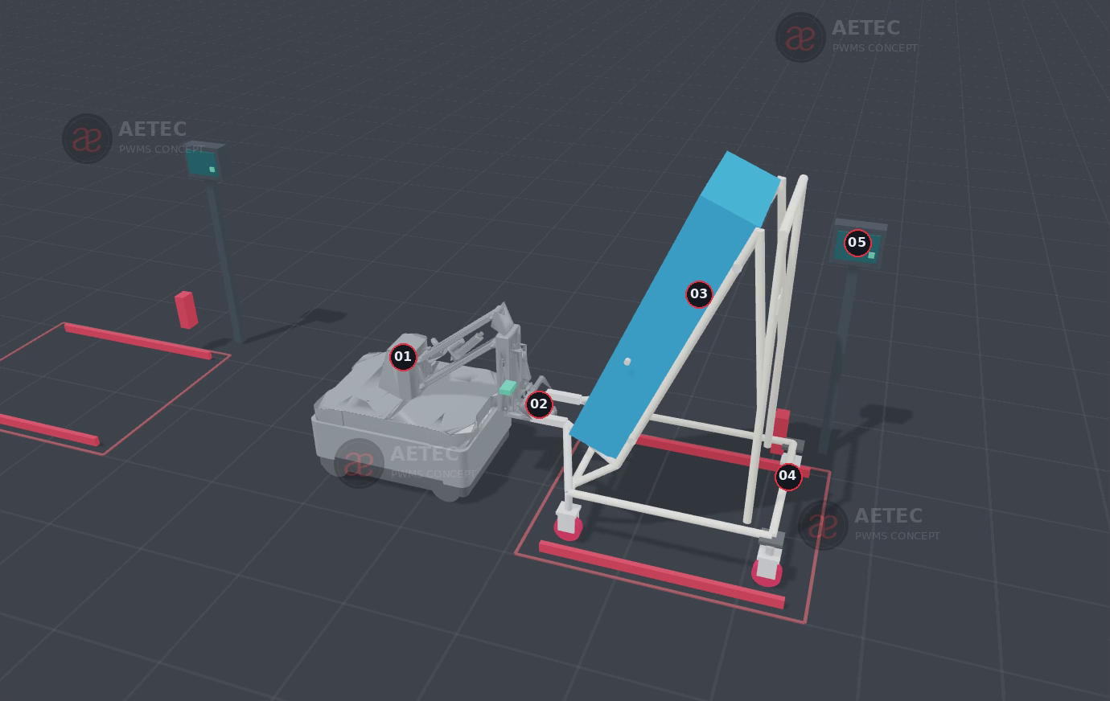
OPTION A / ENGINEERING APPLICATION
A / Existing trolley with Hook
MOST SUITABLE
Incoming through process 15
Retains the existing ergonomic trolley and requires the least carrier change.
Repacking and trolley queues remain. Finished goods use a separate conveyor AMR route.
Capture
Tow
Park / release
S$4.32m
Full scope CAPEX
including ASRS
Engineering concept only. Geometry and cycle time require application validation.
AETEC / Lim Yee Wei / Rev 15 / 14 Oct 2026 / Discussion estimate, SGD excl. GST
07
Notes:
Sources: customer AETEC - ASRS and AMR Mapping R1.xlsx, Marshawn email 13 July 2026; PWMS MiR Hook Phase1 Option1 Proposal Rev3; End-to-End ASRS AMR Options Budgetary Quotation Rev6 (5 September 2026, expired); Five AMR Methods Budgetary Supplement Rev7 (14 September 2026). Raw part 35 kg confirmed by current user instruction, 13 October 2026. All new rates and geometry assumptions are engineering scenarios, not supplier quotations.
Rev14 graphical explanation: Financial inputs remain the Rev13 discussion model. Company logo copied unchanged from Aetec Company Profile v8. Red/black/grey client-deck furniture retained. Concepts need mechanical qualification.
Rev14 graphical explanation: Source image: PWMS Five AMR Methods Rev12.

Slide 8
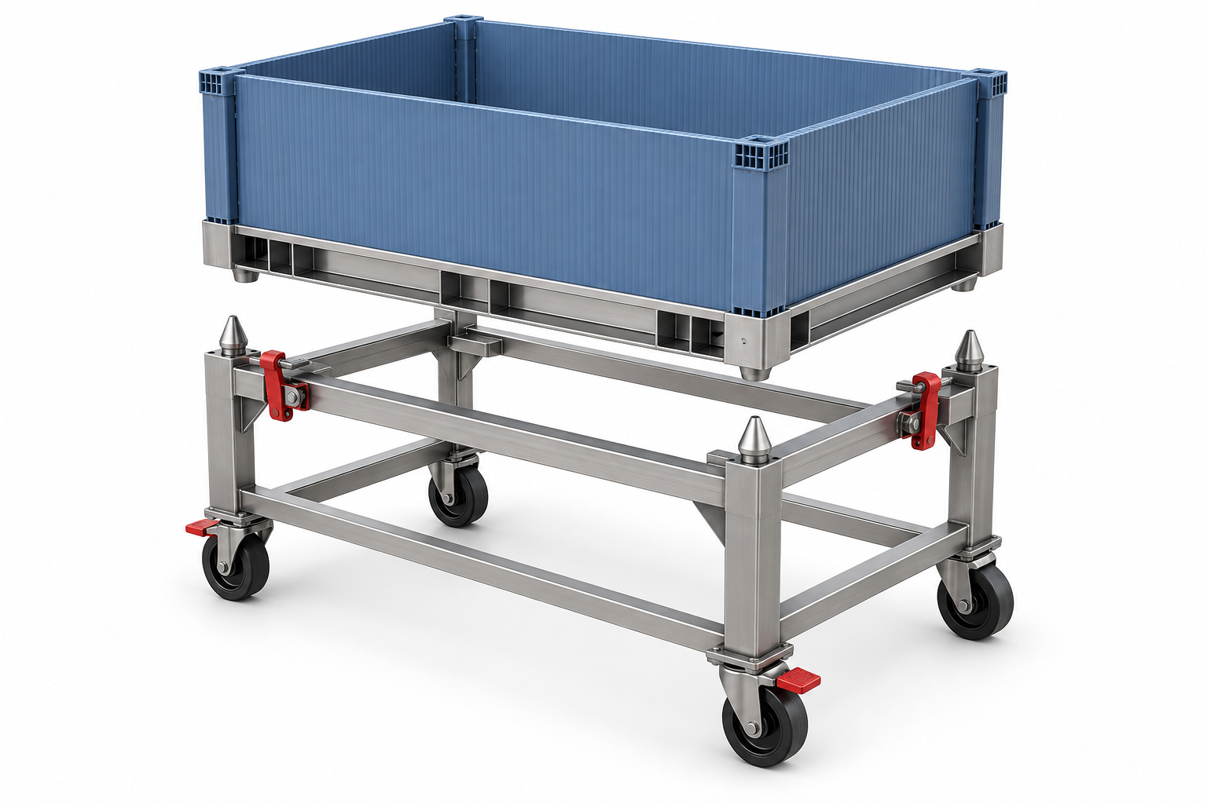
OPTION B / ENGINEERING APPLICATION
B / Common box on every modified trolley
MOST SUITABLE
Manual routes where presentation matters
A common box ID follows the part. Existing trolley height remains available.
All 200 circulating trolleys need conversion. This gives little WIP floor saving.
Locate box
Lock skid
Tow trolley
S$5.81m
Full scope CAPEX
including ASRS
Concept illustration. Box, lock, reach and trolley structure require qualification.
AETEC / Lim Yee Wei / Rev 15 / 14 Oct 2026 / Discussion estimate, SGD excl. GST
08
Notes:
Sources: customer AETEC - ASRS and AMR Mapping R1.xlsx, Marshawn email 13 July 2026; PWMS MiR Hook Phase1 Option1 Proposal Rev3; End-to-End ASRS AMR Options Budgetary Quotation Rev6 (5 September 2026, expired); Five AMR Methods Budgetary Supplement Rev7 (14 September 2026). Raw part 35 kg confirmed by current user instruction, 13 October 2026. All new rates and geometry assumptions are engineering scenarios, not supplier quotations.
Rev14 graphical explanation: Financial inputs remain the Rev13 discussion model. Company logo copied unchanged from Aetec Company Profile v8. Red/black/grey client-deck furniture retained. Concepts need mechanical qualification.
Rev14 graphical explanation: AI-generated concept illustration of a removable container dock, not existing site hardware.

Slide 9
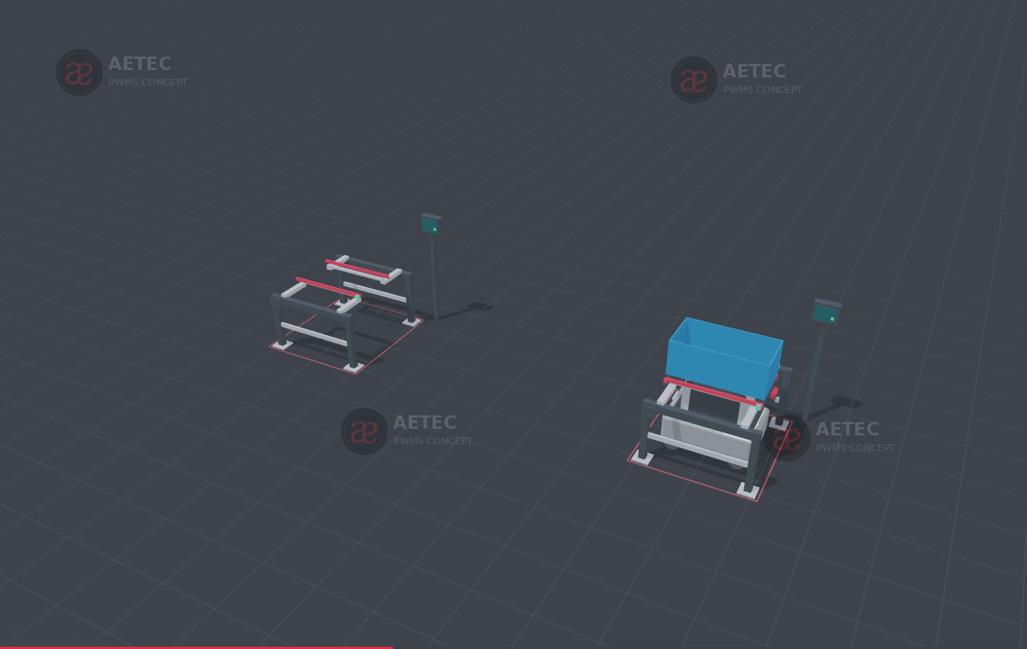
OPTION C / ENGINEERING APPLICATION
C / MiR250 box jack between fixed docks
MOST SUITABLE
Point-to-point buffers and stable docks
Only the box and rigid base travel. Both docking frames stay at the stations.
Custom guided lift and retention need validation. New ergonomic lift stations add cost.
Enter / lift
Carry box
Lower / exit
S$6.07m
Full scope CAPEX
including ASRS
Rigid base required. Unsupported corrugated PP cannot be the jack lifting surface.
AETEC / Lim Yee Wei / Rev 15 / 14 Oct 2026 / Discussion estimate, SGD excl. GST
09
Notes:
Sources: customer AETEC - ASRS and AMR Mapping R1.xlsx, Marshawn email 13 July 2026; PWMS MiR Hook Phase1 Option1 Proposal Rev3; End-to-End ASRS AMR Options Budgetary Quotation Rev6 (5 September 2026, expired); Five AMR Methods Budgetary Supplement Rev7 (14 September 2026). Raw part 35 kg confirmed by current user instruction, 13 October 2026. All new rates and geometry assumptions are engineering scenarios, not supplier quotations.
Rev14 graphical explanation: Financial inputs remain the Rev13 discussion model. Company logo copied unchanged from Aetec Company Profile v8. Red/black/grey client-deck furniture retained. Concepts need mechanical qualification.
Rev14 graphical explanation: Prior C05 render establishes transfer principle only. Older 840 × 450 × 330 mm box, lift stroke and dock dimensions do not approve the larger unified box.

Slide 10
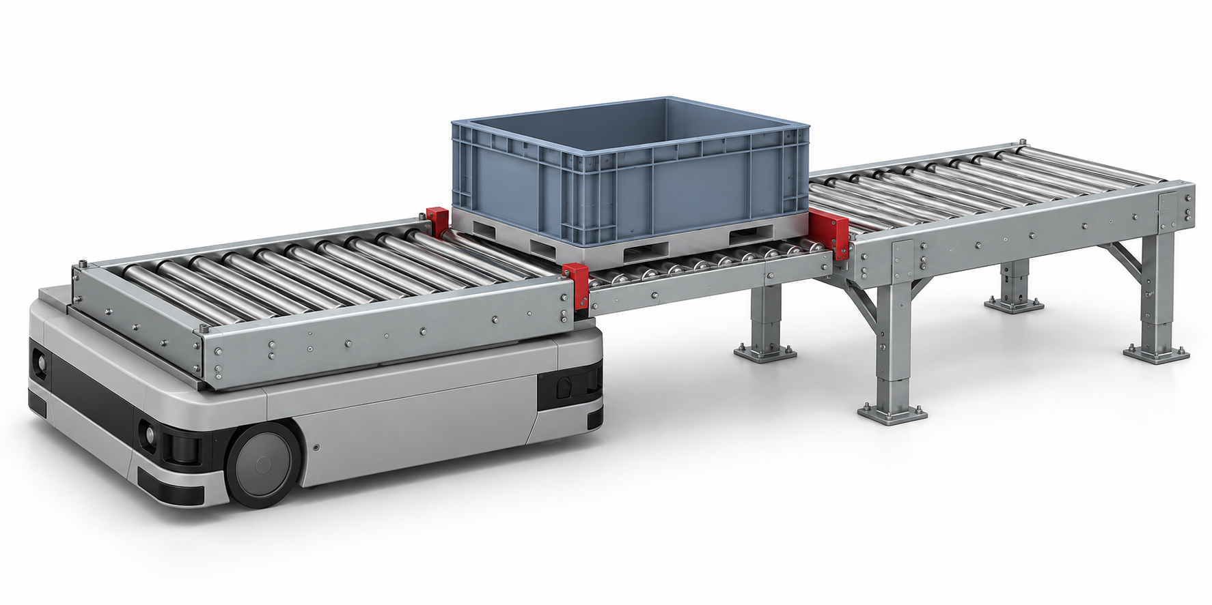
OPTION D / ENGINEERING APPLICATION
D / Conveyor AMR with powered docks
MOST SUITABLE
Repeat transfer lanes and ASRS ports
Automated handoffs suit repeatable transfer planes and conveyor interfaces.
Powered docks, sensors and guarding increase investment. Heights must match.
Align
Prove ready
Roll transfer
S$6.59m
Full scope CAPEX
including ASRS
Engineering concept only. Geometry and cycle time require application validation.
AETEC / Lim Yee Wei / Rev 15 / 14 Oct 2026 / Discussion estimate, SGD excl. GST
10
Notes:
Sources: customer AETEC - ASRS and AMR Mapping R1.xlsx, Marshawn email 13 July 2026; PWMS MiR Hook Phase1 Option1 Proposal Rev3; End-to-End ASRS AMR Options Budgetary Quotation Rev6 (5 September 2026, expired); Five AMR Methods Budgetary Supplement Rev7 (14 September 2026). Raw part 35 kg confirmed by current user instruction, 13 October 2026. All new rates and geometry assumptions are engineering scenarios, not supplier quotations.
Rev14 graphical explanation: Financial inputs remain the Rev13 discussion model. Company logo copied unchanged from Aetec Company Profile v8. Red/black/grey client-deck furniture retained. Concepts need mechanical qualification.
Rev14 graphical explanation: AI-generated concept illustrating horizontal transfer from a fixed powered roller top to a stationary powered dock. Exact MiR model, conveyor, height and guards need application approval.

Slide 11
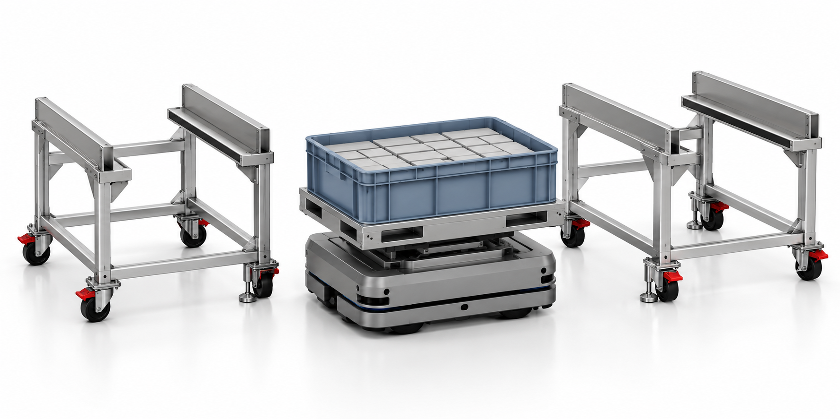
OPTION E / ENGINEERING APPLICATION
E / The box travels, ergonomic docks stay local
Concept illustration. Robot, load and docking geometry remain provisional.
STAYS AT STATION
MOVES WITH AMR
FULL SCOPE CAPEX
34 local trolley docks
retain presentation height
Common box + rigid base
5 jack AMRs in this scenario
S$5.27m
Best pilot candidate for manual stations. Existing trolley structures, locks and lift access must qualify.
AETEC / Lim Yee Wei / Rev 15 / 14 Oct 2026 / Discussion estimate, SGD excl. GST
11
Notes:
Sources: customer AETEC - ASRS and AMR Mapping R1.xlsx, Marshawn email 13 July 2026; PWMS MiR Hook Phase1 Option1 Proposal Rev3; End-to-End ASRS AMR Options Budgetary Quotation Rev6 (5 September 2026, expired); Five AMR Methods Budgetary Supplement Rev7 (14 September 2026). Raw part 35 kg confirmed by current user instruction, 13 October 2026. All new rates and geometry assumptions are engineering scenarios, not supplier quotations.
Rev14 graphical explanation: Financial inputs remain the Rev13 discussion model. Company logo copied unchanged from Aetec Company Profile v8. Red/black/grey client-deck furniture retained. Concepts need mechanical qualification.
Rev14 graphical explanation: AI concept illustration, not exact MiR product geometry or actual site hardware. 34 local docks = 17 process groups × 2. Retire/relocate 166 of 200 trolleys. Assisted part loading remains.

Slide 12
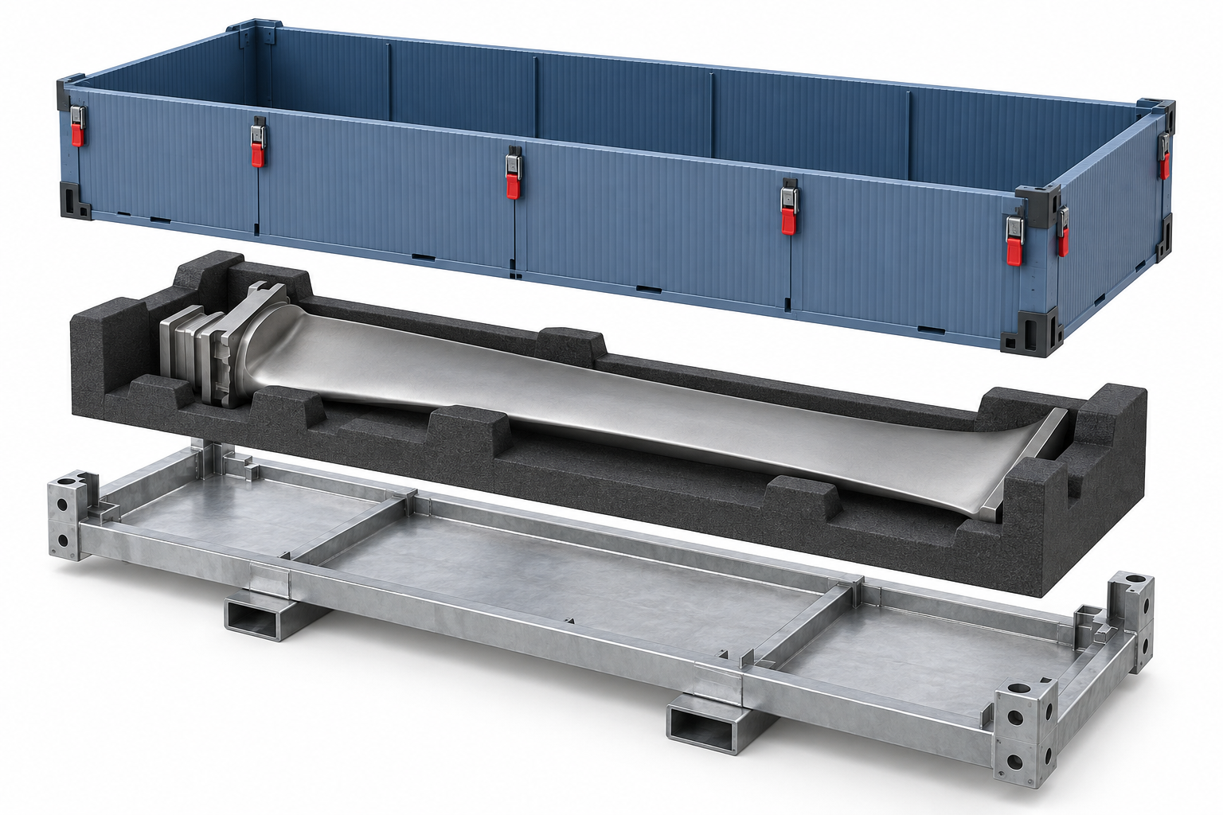
PWMS / CONTAINER STRATEGY
A common box needs a structural load path
PP enclosure
S$120
Replaceable sleeve. Confirm cleaning and chemical compatibility.
Nest + identity
S$90
Protect surfaces and maintain part / container association.
Rigid base / skid
S$250
Carries the load and provides qualified jack / roller contact.
Concept illustration. Container size and protective nest require validation.
S$460 per box set. 1,210 sets in the scenario, plus S$55,000 for design and prototype trials.
AETEC / Lim Yee Wei / Rev 15 / 14 Oct 2026 / Discussion estimate, SGD excl. GST
12
Notes:
Sources: customer AETEC - ASRS and AMR Mapping R1.xlsx, Marshawn email 13 July 2026; PWMS MiR Hook Phase1 Option1 Proposal Rev3; End-to-End ASRS AMR Options Budgetary Quotation Rev6 (5 September 2026, expired); Five AMR Methods Budgetary Supplement Rev7 (14 September 2026). Raw part 35 kg confirmed by current user instruction, 13 October 2026. All new rates and geometry assumptions are engineering scenarios, not supplier quotations.
Rev14 graphical explanation: Financial inputs remain the Rev13 discussion model. Company logo copied unchanged from Aetec Company Profile v8. Red/black/grey client-deck furniture retained. Concepts need mechanical qualification.
Rev14 graphical explanation: AI-generated assembly concept. Not a measured PWMS blade or approved nest. Proposed external envelope 1,400 × 700 × 450 mm, provisional. One standard interface can accept different qualified nests.

Slide 13
PWMS / CONTAINER STRATEGY
Ergonomics changes the station investment
Presentation hardware only, S$ thousand
200 vs 34
Modified trolleys
S$2,500 conversion + S$350 review each
18 × S$28k
Part manipulators: S$504k in every option. Existing reusable units can reduce this.
The model retains assisted part loading. Removing lift/tilt scope requires an accepted operator trial.
AETEC / Lim Yee Wei / Rev 15 / 14 Oct 2026 / Discussion estimate, SGD excl. GST
13
Notes:
Sources: customer AETEC - ASRS and AMR Mapping R1.xlsx, Marshawn email 13 July 2026; PWMS MiR Hook Phase1 Option1 Proposal Rev3; End-to-End ASRS AMR Options Budgetary Quotation Rev6 (5 September 2026, expired); Five AMR Methods Budgetary Supplement Rev7 (14 September 2026). Raw part 35 kg confirmed by current user instruction, 13 October 2026. All new rates and geometry assumptions are engineering scenarios, not supplier quotations.
Rev14 graphical explanation: Financial inputs remain the Rev13 discussion model. Company logo copied unchanged from Aetec Company Profile v8. Red/black/grey client-deck furniture retained. Concepts need mechanical qualification.
Rev14 graphical explanation: C and D: 18 new lift/tilt units × S$45,000. Trolley retirement S$150/unit is in container costs. E retains34 and retires166. Existing manipulators use S$6,500 review each in place of S$28,000 new units after inventory validation.

Slide 14
PWMS / CONTAINER STRATEGY
Queue savings can be offset by the larger ASRS
Planning envelope, m²
A 560 m²
E 572 m²
E queue: −88 m²
E ASRS: +100 m²
Net: +12 m² versus A
Modelled areas are comparison envelopes, not a verified site layout or a rental saving.
AETEC / Lim Yee Wei / Rev 15 / 14 Oct 2026 / Discussion estimate, SGD excl. GST
14
Notes:
Sources: customer AETEC - ASRS and AMR Mapping R1.xlsx, Marshawn email 13 July 2026; PWMS MiR Hook Phase1 Option1 Proposal Rev3; End-to-End ASRS AMR Options Budgetary Quotation Rev6 (5 September 2026, expired); Five AMR Methods Budgetary Supplement Rev7 (14 September 2026). Raw part 35 kg confirmed by current user instruction, 13 October 2026. All new rates and geometry assumptions are engineering scenarios, not supplier quotations.
Rev14 graphical explanation: Financial inputs remain the Rev13 discussion model. Company logo copied unchanged from Aetec Company Profile v8. Red/black/grey client-deck furniture retained. Concepts need mechanical qualification.

Slide 15
PWMS / CONTAINER STRATEGY
A larger box reduces levels and widens the store
Equipment envelope, m²
12 levels
9 levels
21 bays
20.00 × 8.00 m
50 kg load basis
28 bays
26.86 × 9.68 m
55 kg load scenario
Same target: 1,000 cells
4 storage faces, 5.04 m usable height
900 occupied cells at 90%
1,400 × 700 × 450 mm is provisional. Actual box dimensions and heavier-load design need reconciliation.
AETEC / Lim Yee Wei / Rev 15 / 14 Oct 2026 / Discussion estimate, SGD excl. GST
15
Notes:
Sources: customer AETEC - ASRS and AMR Mapping R1.xlsx, Marshawn email 13 July 2026; PWMS MiR Hook Phase1 Option1 Proposal Rev3; End-to-End ASRS AMR Options Budgetary Quotation Rev6 (5 September 2026, expired); Five AMR Methods Budgetary Supplement Rev7 (14 September 2026). Raw part 35 kg confirmed by current user instruction, 13 October 2026. All new rates and geometry assumptions are engineering scenarios, not supplier quotations.
Formula: levels=floor(5.04/(H+0.10)); bays=ceil(cells/(4*levels)); length=bays*(W+0.10)+4.46; width=4*(L+0.10)+3.68. Metres. Includes historic internal aisle allowance; excludes external access, fire enclosure and service zones. Long dimension assumed rack depth; not a validated orientation.
Rev14 graphical explanation: Financial inputs remain the Rev13 discussion model. Company logo copied unchanged from Aetec Company Profile v8. Red/black/grey client-deck furniture retained. Concepts need mechanical qualification.
Rev14 graphical explanation: Historical storage box envelope 980 × 640 × 320 mm differs from prior C05 illustrated 840 × 450 × 330 mm. Storage sizing uses 100 mm allowances, 4.46 m end length and 3.68 m aisles. Calibrated illustration, not approved design.

Slide 16
PWMS / CONTAINER STRATEGY
Fleet size follows demand and transfer time
876
3.33
842
missions / day
travel min / mission
usable min / robot / day
A / B
4 Hook + 2 conveyor AMRs
C / D / E
5 AMRs
Handoff allowance: Hook 1.5 min, jack 0.9 min, conveyor 0.7 min
Capacity screen only. Charging, peak arrivals, congestion and failures need simulation. No N+1 spare included.
AETEC / Lim Yee Wei / Rev 15 / 14 Oct 2026 / Discussion estimate, SGD excl. GST
16
Notes:
Sources: customer AETEC - ASRS and AMR Mapping R1.xlsx, Marshawn email 13 July 2026; PWMS MiR Hook Phase1 Option1 Proposal Rev3; End-to-End ASRS AMR Options Budgetary Quotation Rev6 (5 September 2026, expired); Five AMR Methods Budgetary Supplement Rev7 (14 September 2026). Raw part 35 kg confirmed by current user instruction, 13 October 2026. All new rates and geometry assumptions are engineering scenarios, not supplier quotations.
Rev14 graphical explanation: Financial inputs remain the Rev13 discussion model. Company logo copied unchanged from Aetec Company Profile v8. Red/black/grey client-deck furniture retained. Concepts need mechanical qualification.
Rev14 graphical explanation: 876 = 40 parts/day ×19 moves ×1.10 +40 empty returns. Travel = 2×60m /0.6m/s /60. Effective capacity=24×60×0.65×0.90=842.4 min/day. Hook and conveyor routes use separate pools in A/B.

Slide 17
PWMS / CONTAINER STRATEGY
A has the lowest initial investment
Full-scope CAPEX, S$ million
Includes ASRS, assisted handling and 15% contingency. Historical anchors + engineering allowances, not quotes.
AETEC / Lim Yee Wei / Rev 15 / 14 Oct 2026 / Discussion estimate, SGD excl. GST
17
Notes:
Sources: customer AETEC - ASRS and AMR Mapping R1.xlsx, Marshawn email 13 July 2026; PWMS MiR Hook Phase1 Option1 Proposal Rev3; End-to-End ASRS AMR Options Budgetary Quotation Rev6 (5 September 2026, expired); Five AMR Methods Budgetary Supplement Rev7 (14 September 2026). Raw part 35 kg confirmed by current user instruction, 13 October 2026. All new rates and geometry assumptions are engineering scenarios, not supplier quotations.
Rev14 graphical explanation: Financial inputs remain the Rev13 discussion model. Company logo copied unchanged from Aetec Company Profile v8. Red/black/grey client-deck furniture retained. Concepts need mechanical qualification.

Slide 18
COST BREAKDOWN / SGD THOUSAND
Where the investment goes
Cost group | A | B | C | D | E
Handling | 504.0 | 504.0 | 504.0 | 504.0 | 504.0
Containers | 199.4 | 1181.6 | 641.6 | 641.6 | 733.4
AMR | 724.7 | 724.7 | 722.7 | 792.7 | 722.7
Stations | 370.0 | 370.0 | 1145.0 | 1525.0 | 355.0
Integration | 375.0 | 375.0 | 375.0 | 375.0 | 375.0
ASRS | 1580.0 | 1892.7 | 1892.7 | 1892.7 | 1892.7
Contingency | 563.0 | 757.2 | 792.2 | 859.7 | 687.4
Total | 4316.1 | 5805.2 | 6073.2 | 6590.7 | 5270.3
The next slides show quantities × rates, component subtotals and conditional savings.
AETEC / Lim Yee Wei / Rev 15 / 14 Oct 2026 / Discussion estimate, SGD excl. GST
18
Notes:
Sources: customer AETEC - ASRS and AMR Mapping R1.xlsx, Marshawn email 13 July 2026; PWMS MiR Hook Phase1 Option1 Proposal Rev3; End-to-End ASRS AMR Options Budgetary Quotation Rev6 (5 September 2026, expired); Five AMR Methods Budgetary Supplement Rev7 (14 September 2026). Raw part 35 kg confirmed by current user instruction, 13 October 2026. All new rates and geometry assumptions are engineering scenarios, not supplier quotations.
Rev14 graphical explanation: Financial inputs remain the Rev13 discussion model. Company logo copied unchanged from Aetec Company Profile v8. Red/black/grey client-deck furniture retained. Concepts need mechanical qualification.

Slide 19
COST DISCUSSION / SGD EXCLUDING GST
How the discussion budget is calculated
Quantity × unit allowance
Direct subtotal + 15% development reserve = budget
Input type | Meaning | Confirmation needed
H / Historical | Prior budget price or unit rate | Updated supplier scope and validity
E / Engineering | New allowance or scaled historical rate | Design, quantities and supplier quotation
Customer budget | Same scope across all five options | Agreed scope, quantities and allowances
Unit allowances cover the proposed scope. Current supplier quotes and engineering hours remain to be confirmed.
AETEC / Lim Yee Wei / Rev 15 / 14 Oct 2026 / Discussion estimate, SGD excl. GST
19
Notes:
Basis: PWMS Cost Ledger and Assumptions Rev13, retained baseline, detailed Rev15 discussion model dated 14 October 2026. Historical rates are selling-side budget anchors and engineering allowances, not live supplier quotations. All SGD exclude GST. Rev13 already treats rates as selling-side budget anchors. No markup is inferred or added. The new detail explains existing allowances and preserves the baseline CAPEX totals. Contingency is a separate scope-development allowance, not a statistical confidence interval or margin.

Slide 20
COST DISCUSSION / SGD EXCLUDING GST
The quantities behind the budget
Quantity | Calculation in this scenario | Result
Circulating raw + WIP | 40/day × (2 raw-buffer days + 3 WIP days) | 200 loads
Occupied ASRS positions | 1,000 cells × 90% working occupancy | 900 loads
Common box sets | (900 stored + 200 circulating) × 1.10 reserve | 1,210 sets
FG boxes in A | 900 stored × 1.10 reserve | 990 boxes
Dock positions | 17 process groups × 2 + 4 other interfaces | 38 docks
Existing / local trolleys | 200 inventory / 17 groups × 2 local docks in E | 200 / 34
Part-assistance positions | 17 process groups + 1 incoming point | 18 positions
Planning quantities only. One process group may contain several machines. PWMS must confirm coverage.
AETEC / Lim Yee Wei / Rev 15 / 14 Oct 2026 / Discussion estimate, SGD excl. GST
20
Notes:
Basis: PWMS Cost Ledger and Assumptions Rev13, retained baseline, detailed Rev15 discussion model dated 14 October 2026. Historical rates are selling-side budget anchors and engineering allowances, not live supplier quotations. All SGD exclude GST. 40/day, 3 WIP days, 2 incoming buffer days, 1,000 cells, 90% occupancy and 10% box reserve are assumptions. 17 processes is the retained customer mapping. 18 assistance points is a proposed count, not a verified equipment inventory. Existing trolley inventory remains 200 when WIP assumptions change.

Slide 21
COST DISCUSSION / SGD EXCLUDING GST
Option E budget, from components to total
Direct allowances, S$ thousand
S$4,582,830
Direct subtotal
+ S$687,424
15% × direct subtotal
S$5,270,254
Full-scope budget
Contingency is applied once. Example shows E; the same calculation applies to A–D.
AETEC / Lim Yee Wei / Rev 15 / 14 Oct 2026 / Discussion estimate, SGD excl. GST
21
Notes:
Basis: PWMS Cost Ledger and Assumptions Rev13, retained baseline, detailed Rev15 discussion model dated 14 October 2026. Historical rates are selling-side budget anchors and engineering allowances, not live supplier quotations. All SGD exclude GST. Exact direct subtotal S$4,582,829.614210879; 15% contingency S$687,424.442131632; total S$5,270,254.056342511. Display values round to dollars. All six groups reconcile to the existing ledger.

Slide 22
COST DISCUSSION / SGD EXCLUDING GST
Container costs, including the complete box pool
Item | Qty A / B–E | Unit SGD | A subtotal | B–E subtotal
Design, prototypes and trials | 1 / 1 | 10,000 / 55,000 | 10,000 | 55,000
FG box / common PP sleeve | 990 / 1,210 | 60 / 120 | 59,400 | 145,200
Rigid load-bearing base | 0 / 1,210 | 250 | 0 | 302,500
Protective nest + identification | 0 / 1,210 | 90 | 0 | 108,900
Box pool subtotal |  |  | 69,400 | 611,600
S$460 per common set
120 sleeve + 250 rigid base + 90 nest / identity
AETEC / Lim Yee Wei / Rev 15 / 14 Oct 2026 / Discussion estimate, SGD excl. GST
22
Notes:
Basis: PWMS Cost Ledger and Assumptions Rev13, retained baseline, detailed Rev15 discussion model dated 14 October 2026. Historical rates are selling-side budget anchors and engineering allowances, not live supplier quotations. All SGD exclude GST. Box materials S$556,600 =1,210 ×460. Design/trials S$55,000 gives S$611,600. A:990×60+10,000 =69,400. Trolley costs are separate on the next slide and complete the Containers group. PP rate120 is a legacy proxy. Raw material cost, purchased parts and fabrication labour are not separately quoted in this budget. One 460 rate applies to a complete qualified set, not just corrugated plastic.

Slide 23
COST DISCUSSION / SGD EXCLUDING GST
Trolley changes explain a major part of the difference
Trolley work | Unit SGD | A | B | C / D | E
Hook-only interface | 300 | 200 × 300 | 0 | 0 | 0
Universal box-dock conversion | 2,500 | 0 | 200 × 2,500 | 0 | 34 × 2,500
Inspection / repair allowance | 350 | 200 × 350 | 200 × 350 | 0 | 34 × 350
Retire / relocate unused units | 150 | 0 | 0 | 200 × 150 | 166 × 150
Trolley subtotal, SGD |  | 130,000 | 570,000 | 30,000 | 121,800
Plus box pool, SGD |  | 69,400 | 611,600 | 611,600 | 611,600
Containers group, SGD |  | 199,400 | 1,181,600 | 641,600 | 733,400
E keeps 34 ergonomic trolley docks local. Removing the travelling trolley does not remove assisted part loading.
AETEC / Lim Yee Wei / Rev 15 / 14 Oct 2026 / Discussion estimate, SGD excl. GST
23
Notes:
Basis: PWMS Cost Ledger and Assumptions Rev13, retained baseline, detailed Rev15 discussion model dated 14 October 2026. Historical rates are selling-side budget anchors and engineering allowances, not live supplier quotations. All SGD exclude GST. Universal conversion covers allowance for locators, positive locks, replaceable adapter and proof testing. S$350 is a limited inspection/repair allowance, not an unlimited structural rebuild. Retirement has no scrap credit. Existing inventory200 is independent of WIP. New trolley shells, if required beyond existing inventory, need a separate quotation.

Slide 24
COST DISCUSSION / SGD EXCLUDING GST
AMR budget, with quantities and unit allowances
Fleet item | Unit SGD | A / B qty | C / E qty | D qty
Hook hardware, historical rate | 79,000 | 4 | 0 | 0
MiR250 + jack module | 95,000 + 24,000 | 0 | 5 | 0
MiR250 + conveyor module | 95,000 + 38,000 | 2 | 0 | 5
Chargers | 8,400 | 3 | 3 | 3
Fleet licence allowance | 27,500 | 1 | 1 | 1
Logistics / commissioning per robot | 15,000 | 6 | 5 | 5
AMR group subtotal, SGD |  | 724,700 | 722,700 | 792,700
Example C/E: 5 × 119,000 + 3 × 8,400 + 27,500 + 5 × 15,000 = S$722,700.
AETEC / Lim Yee Wei / Rev 15 / 14 Oct 2026 / Discussion estimate, SGD excl. GST
24
Notes:
Basis: PWMS Cost Ledger and Assumptions Rev13, retained baseline, detailed Rev15 discussion model dated 14 October 2026. Historical rates are selling-side budget anchors and engineering allowances, not live supplier quotations. All SGD exclude GST. Hook79k and base95k are historical anchors, not confirmed current offers. Jack24k is custom engineering allowance. Base anchor includes a freight proxy; reconcile this with the separate logistics/commissioning allowance to avoid overlap when formal quotes arrive. Do not add old all-in AMR bundles. Fleet is capacity screen only; no N+1 spare included.

Slide 25
COST DISCUSSION / SGD EXCLUDING GST
Docking and ergonomic stations are separate costs
Station item | Unit SGD | A / B qty | C qty | D qty | E qty
Interface qualification | 20k / 45k / 65k | 1 × 20k | 1 × 45k | 1 × 45k | 1 × 65k
Station gateway | 7,000 | 17 | 17 | 17 | 17
Passive / restrained dock | 4,500 | 32 | 38 | 0 | 38
Powered transfer dock | 14,500 | 6 | 0 | 38 | 0
Ergonomic lift / tilt upgrade | 45,000 | 0 | 18 | 18 | 0
Stations subtotal, SGD |  | 370,000 | 1,145,000 | 1,525,000 | 355,000
C / D: 18 × S$45,000 = S$810,000
E uses qualified local trolley docks instead. Powered docks alone do not guarantee ergonomic reach or height.
AETEC / Lim Yee Wei / Rev 15 / 14 Oct 2026 / Discussion estimate, SGD excl. GST
25
Notes:
Basis: PWMS Cost Ledger and Assumptions Rev13, retained baseline, detailed Rev15 discussion model dated 14 October 2026. Historical rates are selling-side budget anchors and engineering allowances, not live supplier quotations. All SGD exclude GST. Gateway allowance includes ID/call/presence/enable. Passive or powered dock hardware is separate, without another call-point charge. Lift/tilt is an upgrade at selected positions, additional to transfer docks. 4 extra interfaces are included in38. Machine fixture access, guard interfaces and dock load retention still require design.

Slide 26
COST DISCUSSION / SGD EXCLUDING GST
Qualified manipulator reuse can reduce the budget
Handling allowance before contingency, S$ thousand
S$21,500
Direct saving per approved reuse
28,000 new − 6,500 review
S$24,725
Budget reduction per unit
including 15% reserve
A review allowance excludes major repairs, new grippers and alterations. Reuse depends on load, reach and duty.
AETEC / Lim Yee Wei / Rev 15 / 14 Oct 2026 / Discussion estimate, SGD excl. GST
26
Notes:
Basis: PWMS Cost Ledger and Assumptions Rev13, retained baseline, detailed Rev15 discussion model dated 14 October 2026. Historical rates are selling-side budget anchors and engineering allowances, not live supplier quotations. All SGD exclude GST. All options baseline18 new units×28k=504k. Reuse6 =>375k;12 =>246k;18 =>117k. Saving18 direct387k, budget445,050. Nominal assistance-class selection requires35kg part plus tooling and application approval. Do not remove lifting assistance to manufacture a saving.

Slide 27
COST DISCUSSION / SGD EXCLUDING GST
Integration budget and the work it covers
Work package | Qty × allowance | Deliverable / cost discussion
Wi-Fi survey and upgrades | 1 × S$55,000 | Coverage survey, access-point work and acceptance
Part / box traceability | 1 × S$70,000 | ID association, event history and recovery records
Route and dispatch model | 1 × S$60,000 | Station routing, mission rules and dispatch logic
PWMS / machine / ASRS interfaces | 1 × S$60,000 | Agreed data and handshake endpoints
Orchestration validation | 1 × S$30,000 | Normal, blocked, failed and recovery scenarios
Rollout, FAT, SAT and training | 1 × S$100,000 | Transport-system acceptance and handover
Integration group subtotal | S$375,000 | Applies once to each complete option
S$70k + S$60k explains the existing S$130k software allowance. It is not an additional platform charge.
AETEC / Lim Yee Wei / Rev 15 / 14 Oct 2026 / Discussion estimate, SGD excl. GST
27
Notes:
Basis: PWMS Cost Ledger and Assumptions Rev13, retained baseline, detailed Rev15 discussion model dated 14 October 2026. Historical rates are selling-side budget anchors and engineering allowances, not live supplier quotations. All SGD exclude GST. Historical70k event model plus60k route model. Remaining packages are existing Rev13 allowances. No verified engineer-hour breakdown is available. Request task hours, hourly rates, device quantities and existing-system reuse credits during scoping; do not present invented hours as quoted evidence. WCS and ASRS PLC remain separate control responsibilities.

Slide 28
COST DISCUSSION / SGD EXCLUDING GST
ASRS breakdown, mechanical equipment
Equipment | A / FG SGD | B–E calculation | B–E SGD
Design and load validation | 125,000 | 125,000 × 1.20 | 150,000
Racks | 215,000 | 215,000 × 1.62503 | 349,381
Two cranes | 370,000 | 2 × 185,000 × 1.10 | 407,000
Two guarded I/O ports | 100,000 | 2 × 50,000 × 1.15 | 115,000
ASRS carriers + 3% spare | 175,000 | 175,000 × 1.30 | 227,500
Mechanical subtotal | 985,000 |  | 1,248,881
Scaling factors are budget assumptions. Crane capacity, rack structure and carrier dimensions need supplier design.
AETEC / Lim Yee Wei / Rev 15 / 14 Oct 2026 / Discussion estimate, SGD excl. GST
28
Notes:
Basis: PWMS Cost Ledger and Assumptions Rev13, retained baseline, detailed Rev15 discussion model dated 14 October 2026. Historical rates are selling-side budget anchors and engineering allowances, not live supplier quotations. All SGD exclude GST. Racks areaFactor =260.0048/160=1.62503 at1,000cells. Crane load factor=max(1,55/50)=1.10, an allowance not OEM load selection. Design1.20, guardedI/O1.15 and carriers1.30 are assumed factors. Container pool and ASRS carrier stock are distinct scopes; check whether final mechanical design combines these components and remove overlap only after agreement.

Slide 29
COST DISCUSSION / SGD EXCLUDING GST
ASRS breakdown, controls and implementation
Work package | A / FG SGD | B–E calculation | B–E SGD
PLC and safety controls | 160,000 | 1 × 160,000 | 160,000
Warehouse control system (WCS) | 80,000 | 1 × 80,000 | 80,000
Transport API | 45,000 | 1 × 45,000 | 45,000
Freight, rigging and installation | 115,000 | 115,000 × √1.62503 | 146,598
FAT, SAT, validation and training | 115,000 | 115,000 × 1.15 | 132,250
Initial spares and warranty | 80,000 | 1 × 80,000 | 80,000
Controls / implementation subtotal | 595,000 |  | 643,848
Total ASRS incl. mechanical | 1,580,000 |  | 1,892,730
ASRS total is before the common 15% reserve. Store-side acceptance is separate from transport-system acceptance.
AETEC / Lim Yee Wei / Rev 15 / 14 Oct 2026 / Discussion estimate, SGD excl. GST
29
Notes:
Basis: PWMS Cost Ledger and Assumptions Rev13, retained baseline, detailed Rev15 discussion model dated 14 October 2026. Historical rates are selling-side budget anchors and engineering allowances, not live supplier quotations. All SGD exclude GST. Mechanical and remaining subsystem amounts sum to A1,580,000 and unified1,892,729.6142. Freight146,598.1642 is the square-root area scaling allowance. FAT132,250. PLC/WCS/API160k/80k/45k. Avoid duplicate platform, freight and system-acceptance scope in formal quotations. Round display values to dollars; unrounded calculation controls totals.

Slide 30
COST DISCUSSION / SGD EXCLUDING GST
Cost reduction opportunities for Option E
Independent scenarios versus E baseline, including 15% reserve, S$ thousand
Qualified existing units
Measured route permits
3 instead of 5 robots
Supplier redesign retains
load path and protection
Box pool falls to 1,122
200-trolley inventory stays
These scenarios are conditional. Combined changes must be recalculated together, especially fleet and charging.
AETEC / Lim Yee Wei / Rev 15 / 14 Oct 2026 / Discussion estimate, SGD excl. GST
30
Notes:
Basis: PWMS Cost Ledger and Assumptions Rev13, retained baseline, detailed Rev15 discussion model dated 14 October 2026. Historical rates are selling-side budget anchors and engineering allowances, not live supplier quotations. All SGD exclude GST. Savings:445,050;317,860;69,575;46,552 respectively. WIP decrease saves88 box sets×460×1.15.166 trolley retirements stay in scope. Route30m model cuts2jackAMRs,1charger and2commissioning allowances. S$50 per set saving is a negotiated target, not a received quote. No safety, required ergonomic scope or mandatory validation is removed.

Slide 31
COST DISCUSSION / SGD EXCLUDING GST
A combined scenario gives a discussion target
Full-scope budget, S$ million
S$4.609m
Conditional target
S$661,112 below baseline
6 new + 12 reviewed assists
1,122 box sets
3 jack AMRs + 2 chargers
34 local trolley docks
ASRS capacity and all 38 docks remain. 166 existing trolleys still require relocation / retirement.
AETEC / Lim Yee Wei / Rev 15 / 14 Oct 2026 / Discussion estimate, SGD excl. GST
31
Notes:
Basis: PWMS Cost Ledger and Assumptions Rev13, retained baseline, detailed Rev15 discussion model dated 14 October 2026. Historical rates are selling-side budget anchors and engineering allowances, not live supplier quotations. All SGD exclude GST. Sequential recalculation:5,270,254.0563 ->4,973,554.0563 ->4,927,002.0563 ->4,609,142.0563. This keeps original trolley inventory200 fixed. Exact delta661,112. Conditions:12suitable existing manipulators,1dayWIP accepted by production,30m mean one-way routing achievable and3robots meet peak demand. No supplier discount is assumed.

Slide 32
COST DISCUSSION / SGD EXCLUDING GST
Phasing changes cash timing, not the full-system total
Illustrative budget allocation, S$ million
S$3.094m now
Transport, containers,
assistance and integration
S$2.177m later
ASRS + allocated reserve
Retains S$5.270m full total
A phased plan needs an accepted interim store and interfaces. Repeat mobilisation, rework and escalation are unpriced.
AETEC / Lim Yee Wei / Rev 15 / 14 Oct 2026 / Discussion estimate, SGD excl. GST
32
Notes:
Basis: PWMS Cost Ledger and Assumptions Rev13, retained baseline, detailed Rev15 discussion model dated 14 October 2026. Historical rates are selling-side budget anchors and engineering allowances, not live supplier quotations. All SGD exclude GST. Illustrative timing only:ASRS1,892,729.6142×1.15=2,176,639.0563; remaining3,093,615. Keep full baseline box pool and common integration conservatively. Does not claim functional equivalence to an installed ASRS during phase1. Historical pilot292,800 remains separate and may overlap production costs; do not simply add it to rollout without credits.

Slide 33
PWMS / CONTAINER STRATEGY
Different scope explains the increase from old ROMs
Historical anchor | Old scope | Current treatment
Hook option 1A / six-Hook | S$603,900 / S$1,168,200 | Old route bundle and 20-trolley initial batch
FG-ASRS | S$1,580,000 | Retained as A base; larger / heavier box re-costed
Unified box + six lift AMRs | S$3,000,000 | Earlier unqualified container and handling assumptions
C05 two-dock pilot | S$194,400 | One route only; not a 17-station factory rollout
Complete scenarios | S$4.32m–S$6.59m | Adds full container pool, assists, station scope and reserve
Do not add the old bundles to this component model. September quotation validity has expired.
AETEC / Lim Yee Wei / Rev 15 / 14 Oct 2026 / Discussion estimate, SGD excl. GST
33
Notes:
Sources: customer AETEC - ASRS and AMR Mapping R1.xlsx, Marshawn email 13 July 2026; PWMS MiR Hook Phase1 Option1 Proposal Rev3; End-to-End ASRS AMR Options Budgetary Quotation Rev6 (5 September 2026, expired); Five AMR Methods Budgetary Supplement Rev7 (14 September 2026). Raw part 35 kg confirmed by current user instruction, 13 October 2026. All new rates and geometry assumptions are engineering scenarios, not supplier quotations.
Rev14 graphical explanation: Financial inputs remain the Rev13 discussion model. Company logo copied unchanged from Aetec Company Profile v8. Red/black/grey client-deck furniture retained. Concepts need mechanical qualification.

Slide 34
PWMS / CONTAINER STRATEGY
Five-year cost includes attendance and support
Five-year total cost, S$ million
A S$5.65m
E S$6.13m
No production uplift or
quality saving credited.
Undiscounted model.
The comparison uses the same scope and operating assumptions. It does not promise headcount reduction.
AETEC / Lim Yee Wei / Rev 15 / 14 Oct 2026 / Discussion estimate, SGD excl. GST
34
Notes:
Sources: customer AETEC - ASRS and AMR Mapping R1.xlsx, Marshawn email 13 July 2026; PWMS MiR Hook Phase1 Option1 Proposal Rev3; End-to-End ASRS AMR Options Budgetary Quotation Rev6 (5 September 2026, expired); Five AMR Methods Budgetary Supplement Rev7 (14 September 2026). Raw part 35 kg confirmed by current user instruction, 13 October 2026. All new rates and geometry assumptions are engineering scenarios, not supplier quotations.
Annual OPEX = task hours*SGD25/hour +3% of eligible installed cost (excluding containers and contingency) +SGD600/robot/year energy +5% annual PP replacement. Space opportunity cost defaults to zero. 250 operating days; five years undiscounted. Actual service contracts replace support proxy.
Rev14 graphical explanation: Financial inputs remain the Rev13 discussion model. Company logo copied unchanged from Aetec Company Profile v8. Red/black/grey client-deck furniture retained. Concepts need mechanical qualification.

Slide 35
PWMS / CONTAINER STRATEGY
E needs about 10 years to recover its extra CAPEX
S$ million versus A
+S$954k
Extra installed CAPEX
S$95k/year
Modelled net saving
Payback: 10.0 years
E merits an ergonomic / flow pilot. It is not a demonstrated five-year financial winner over A.
AETEC / Lim Yee Wei / Rev 15 / 14 Oct 2026 / Discussion estimate, SGD excl. GST
35
Notes:
Sources: customer AETEC - ASRS and AMR Mapping R1.xlsx, Marshawn email 13 July 2026; PWMS MiR Hook Phase1 Option1 Proposal Rev3; End-to-End ASRS AMR Options Budgetary Quotation Rev6 (5 September 2026, expired); Five AMR Methods Budgetary Supplement Rev7 (14 September 2026). Raw part 35 kg confirmed by current user instruction, 13 October 2026. All new rates and geometry assumptions are engineering scenarios, not supplier quotations.
Rev14 graphical explanation: Financial inputs remain the Rev13 discussion model. Company logo copied unchanged from Aetec Company Profile v8. Red/black/grey client-deck furniture retained. Concepts need mechanical qualification.

Slide 36
PWMS / CONTAINER STRATEGY
Sensitivity: test the assumptions that move the result
Scenario | A / S$m | B / S$m | C / S$m | D / S$m | E / S$m
18 existing assists reused | 3.87 | 5.36 | 5.63 | 6.15 | 4.83
Route distance 30 m | 4.03 | 5.52 | 5.76 | 6.24 | 4.95
Route distance 90 m | 4.54 | 6.03 | 6.39 | 6.76 | 5.59
WIP reduced to 1 day | 4.27 | 5.51 | 6.03 | 6.54 | 5.22
No new lift/tilt in C/D | 4.32 | 5.81 | 5.14 | 5.66 | 5.27
Removing ergonomic hardware changes service scope; it is not an equivalent saving until the operator trial passes.
AETEC / Lim Yee Wei / Rev 15 / 14 Oct 2026 / Discussion estimate, SGD excl. GST
36
Notes:
Sources: customer AETEC - ASRS and AMR Mapping R1.xlsx, Marshawn email 13 July 2026; PWMS MiR Hook Phase1 Option1 Proposal Rev3; End-to-End ASRS AMR Options Budgetary Quotation Rev6 (5 September 2026, expired); Five AMR Methods Budgetary Supplement Rev7 (14 September 2026). Raw part 35 kg confirmed by current user instruction, 13 October 2026. All new rates and geometry assumptions are engineering scenarios, not supplier quotations.
Rev14 graphical explanation: Financial inputs remain the Rev13 discussion model. Company logo copied unchanged from Aetec Company Profile v8. Red/black/grey client-deck furniture retained. Concepts need mechanical qualification.
Rev15: existing trolley inventory fixed at200 in all sensitivity cases. Unused units retain relocation/retirement costs. New trolley shells above available inventory are unpriced and must be quoted separately.

Slide 37
PWMS / CONTAINER STRATEGY
Batch transport is a route-specific sixth study
POTENTIAL APPLICATION
MASS IS NOT CAPACITY
MiR600 Shelf Lift or a larger carrier for store-to-buffer milk runs. Reserve individual retrieval at each destination.
A larger robot can carry more mass, but a 1,400 mm box may limit slots first. Do not retain the old eight-box assumption.
COST ANCHOR
SERVICE PENALTY
Earlier five-MiR600 Shelf Lift fleet ROM: S$740,200. Historical scope only; carriers and docks need new design.
At 40 parts/day over 24 h, a four-part batch takes about 0.9 h average fill delay with uniform arrivals and no timeout.
Batch delay = (b − 1)/(2 × arrival rate). A practical timeout reduces delay but also reduces batch utilisation.
AETEC / Lim Yee Wei / Rev 15 / 14 Oct 2026 / Discussion estimate, SGD excl. GST
37
Notes:
Sources: customer AETEC - ASRS and AMR Mapping R1.xlsx, Marshawn email 13 July 2026; PWMS MiR Hook Phase1 Option1 Proposal Rev3; End-to-End ASRS AMR Options Budgetary Quotation Rev6 (5 September 2026, expired); Five AMR Methods Budgetary Supplement Rev7 (14 September 2026). Raw part 35 kg confirmed by current user instruction, 13 October 2026. All new rates and geometry assumptions are engineering scenarios, not supplier quotations.
Rev14 graphical explanation: Financial inputs remain the Rev13 discussion model. Company logo copied unchanged from Aetec Company Profile v8. Red/black/grey client-deck furniture retained. Concepts need mechanical qualification.

Slide 38
PWMS / CONTAINER STRATEGY
Traceability follows the part at every handoff
Part + box
Station
Mission
ASRS
Serial / lot
Container / nest ID
Arrival / release
Origin / destination
Reservation / lock
Load presence
Location / status
Entry / exit
Quality authority
PASS / HOLD / rework
Blocked dock, scan failure or mismatch:
queue, reconcile and recover under authority.
A common box helps identity continuity. PLCs, Fleet and WCS retain their motion and inventory authority.
AETEC / Lim Yee Wei / Rev 15 / 14 Oct 2026 / Discussion estimate, SGD excl. GST
38
Notes:
Sources: customer AETEC - ASRS and AMR Mapping R1.xlsx, Marshawn email 13 July 2026; PWMS MiR Hook Phase1 Option1 Proposal Rev3; End-to-End ASRS AMR Options Budgetary Quotation Rev6 (5 September 2026, expired); Five AMR Methods Budgetary Supplement Rev7 (14 September 2026). Raw part 35 kg confirmed by current user instruction, 13 October 2026. All new rates and geometry assumptions are engineering scenarios, not supplier quotations.
Rev14 graphical explanation: Financial inputs remain the Rev13 discussion model. Company logo copied unchanged from Aetec Company Profile v8. Red/black/grey client-deck furniture retained. Concepts need mechanical qualification.
Rev14 graphical explanation: HOLD requires segregation and approved release. Never allow a transport event to override quality status. Preserve serial, router revision, box, nest, trolley where used, station, mission and WCS IDs.

Slide 39
PWMS / CONTAINER STRATEGY
Select the architecture by the binding constraint
Customer priority | Candidate | Condition to demonstrate
Lowest initial capital / minimal change | A / Retain | Trolleys serviceable; repacking acceptable
One common container, retain all ergonomics | B / Adapt all | Full trolley conversion justified despite floor use
Compact buffers and flexible point-to-point flow | C / Jack | Container access / lift stations and clearance approved
Repeatable automatic transfer lanes | D / Conveyor | Measured transfer frequency pays for powered docks
Preserve ergonomics with fewer circulating trolleys | E / Hybrid | Stationary trolley dock safely accepts the rigid base
Ask PWMS to weight capital, floor constraints, labour, process access and change risk before selecting.
AETEC / Lim Yee Wei / Rev 15 / 14 Oct 2026 / Discussion estimate, SGD excl. GST
39
Notes:
Sources: customer AETEC - ASRS and AMR Mapping R1.xlsx, Marshawn email 13 July 2026; PWMS MiR Hook Phase1 Option1 Proposal Rev3; End-to-End ASRS AMR Options Budgetary Quotation Rev6 (5 September 2026, expired); Five AMR Methods Budgetary Supplement Rev7 (14 September 2026). Raw part 35 kg confirmed by current user instruction, 13 October 2026. All new rates and geometry assumptions are engineering scenarios, not supplier quotations.
Rev14 graphical explanation: Financial inputs remain the Rev13 discussion model. Company logo copied unchanged from Aetec Company Profile v8. Red/black/grey client-deck furniture retained. Concepts need mechanical qualification.

Slide 40
PWMS / CONTAINER STRATEGY
Six gates before factory rollout
01
02
03
Measure
Prototype
Operator trial
Loads, dimensions,
route and inventory
Base, nest, locks
and product protection
Reach, height, tilt
and fixture access
04
05
06
AMR pilot
Store + fleet
Commercial
Handoff time, ID
and safe recovery
ASRS capacity, peaks
and failure response
Matched scope, quotes
and FAT / SAT criteria
Pilot E against an A control route. Keep C and D available until trials resolve the actual handoff.
AETEC / Lim Yee Wei / Rev 15 / 14 Oct 2026 / Discussion estimate, SGD excl. GST
40
Notes:
Sources: customer AETEC - ASRS and AMR Mapping R1.xlsx, Marshawn email 13 July 2026; PWMS MiR Hook Phase1 Option1 Proposal Rev3; End-to-End ASRS AMR Options Budgetary Quotation Rev6 (5 September 2026, expired); Five AMR Methods Budgetary Supplement Rev7 (14 September 2026). Raw part 35 kg confirmed by current user instruction, 13 October 2026. All new rates and geometry assumptions are engineering scenarios, not supplier quotations.
Rev14 graphical explanation: Financial inputs remain the Rev13 discussion model. Company logo copied unchanged from Aetec Company Profile v8. Red/black/grey client-deck furniture retained. Concepts need mechanical qualification.

Slide 41
PWMS / CONTAINER STRATEGY
A pilot is a bounded engineering experiment
Pilot cost element | Scenario allowance, SGD | Scope
Historical C05 pilot anchor | 194,400 | One AMR, two docks, commissioning; revise load basis
35 kg load redesign and validation | 25,000 | Custom lift, retention and rigid-base engineering delta
Ten prototype bases / boxes / nests | 4,600 | 10 × S$460 material allowance
Two trolley receiver conversions | 5,000 | 2 × S$2,500; verify structural suitability
Prototype quality / fit trials | 15,000 | Product protection, process and operator trials
Subtotal + 20% development allowance | 292,800 | 244,000 subtotal +48,800 contingency
Excludes new manipulators, production ASRS and full software. Add S$28,000 per new assistance point if needed.
AETEC / Lim Yee Wei / Rev 15 / 14 Oct 2026 / Discussion estimate, SGD excl. GST
41
Notes:
Sources: customer AETEC - ASRS and AMR Mapping R1.xlsx, Marshawn email 13 July 2026; PWMS MiR Hook Phase1 Option1 Proposal Rev3; End-to-End ASRS AMR Options Budgetary Quotation Rev6 (5 September 2026, expired); Five AMR Methods Budgetary Supplement Rev7 (14 September 2026). Raw part 35 kg confirmed by current user instruction, 13 October 2026. All new rates and geometry assumptions are engineering scenarios, not supplier quotations.
Pilot engineering scenario, not supplier quotation. Two original dock costs retained as conservative provision while trolley receivers are developed. Ten prototypes priced at repeat material rate plus separate design/testing allowances. Manipulator addition before contingency, if required.
Rev14 graphical explanation: Financial inputs remain the Rev13 discussion model. Company logo copied unchanged from Aetec Company Profile v8. Red/black/grey client-deck furniture retained. Concepts need mechanical qualification.

Slide 42
PWMS / CONTAINER STRATEGY
Confirm these inputs with PWMS before pricing supply
PHYSICAL / PROCESS
DEMAND / SPACE
Raw and finished dimensions; part mass by stage; PP material; trolley drawings; machine fixture access; FPI / wash / cleanliness rules.
Actual daily / peak demand; travel distances; WIP and storage mix; aisle and fire constraints; 17 groups versus individual machines.
PEOPLE / EQUIPMENT
COMMERCIAL
Existing manipulators and payloads; acceptable operator reach / height; automatic handoff expectations; maintenance and fallback ownership.
New box quantities and shipping usage; cells versus occupied storage; support SLA; integration access; civil / enclosure scope and current quotations.
We may have misunderstood parts of the process. PWMS should review internally; Aetec can arrange a technical meeting.
AETEC / Lim Yee Wei / Rev 15 / 14 Oct 2026 / Discussion estimate, SGD excl. GST
42
Notes:
Sources: customer AETEC - ASRS and AMR Mapping R1.xlsx, Marshawn email 13 July 2026; PWMS MiR Hook Phase1 Option1 Proposal Rev3; End-to-End ASRS AMR Options Budgetary Quotation Rev6 (5 September 2026, expired); Five AMR Methods Budgetary Supplement Rev7 (14 September 2026). Raw part 35 kg confirmed by current user instruction, 13 October 2026. All new rates and geometry assumptions are engineering scenarios, not supplier quotations.
Rev14 graphical explanation: Financial inputs remain the Rev13 discussion model. Company logo copied unchanged from Aetec Company Profile v8. Red/black/grey client-deck furniture retained. Concepts need mechanical qualification.

Slide 43
RATE REGISTER / H = HISTORICAL, E = ENGINEERING
Appendix / principal cost rates
Item | Unit rate, SGD | Basis / boundary
Hook robot / charger | 79,000 / 8,400 | H: hardware; current availability unconfirmed
MiR250 base + conveyor top | 95,000 +38,000 | H: component anchors; common commissioning separate
MiR250 base + jack module | 95,000 +24,000 | H/E: custom module needs load-case qualification
Fleet / per-robot commissioning | 27,500 / 15,000 | H/E: one licence provision and robot allowance
Passive / powered dock | 4,500 / 14,500 | E: reserved dock hardware scope, no double call kit
Gateway / universal trolley conversion | 7,000 / 2,500 | H/E: one gateway per group; conversion per trolley
Rates are historical anchors or engineering allowances. Quantities and scope appear in this comparison.
AETEC / Lim Yee Wei / Rev 15 / 14 Oct 2026 / Discussion estimate, SGD excl. GST
43
Notes:
Sources: customer AETEC - ASRS and AMR Mapping R1.xlsx, Marshawn email 13 July 2026; PWMS MiR Hook Phase1 Option1 Proposal Rev3; End-to-End ASRS AMR Options Budgetary Quotation Rev6 (5 September 2026, expired); Five AMR Methods Budgetary Supplement Rev7 (14 September 2026). Raw part 35 kg confirmed by current user instruction, 13 October 2026. All new rates and geometry assumptions are engineering scenarios, not supplier quotations.
Rev14 graphical explanation: Financial inputs remain the Rev13 discussion model. Company logo copied unchanged from Aetec Company Profile v8. Red/black/grey client-deck furniture retained. Concepts need mechanical qualification.

Slide 44
PWMS / CONTAINER STRATEGY
Appendix / common integration and exclusions
Included in all options | Scenario allowance | Separately resolved scope
Wi-Fi survey and upgrade | S$55,000 | Major building-network replacement
Route model + traceability | S$130,000 | ERP/MES licence purchases beyond interface work
PWMS / ASRS / machine interfaces | S$60,000 | Production-machine redesign and automatic tending
Orchestration validation | S$30,000 | Unspecified third-party integration scope
Transport FAT / SAT / rollout | S$100,000 | Production downtime / shutdown premiums
Design-development contingency | 15% of listed direct cost | GST, financing, major civil / fire enclosure works
ASRS has its own controls, WCS and acceptance allowance. No unverified platform-reuse credit is deducted.
AETEC / Lim Yee Wei / Rev 15 / 14 Oct 2026 / Discussion estimate, SGD excl. GST
44
Notes:
Sources: customer AETEC - ASRS and AMR Mapping R1.xlsx, Marshawn email 13 July 2026; PWMS MiR Hook Phase1 Option1 Proposal Rev3; End-to-End ASRS AMR Options Budgetary Quotation Rev6 (5 September 2026, expired); Five AMR Methods Budgetary Supplement Rev7 (14 September 2026). Raw part 35 kg confirmed by current user instruction, 13 October 2026. All new rates and geometry assumptions are engineering scenarios, not supplier quotations.
Rev14 graphical explanation: Financial inputs remain the Rev13 discussion model. Company logo copied unchanged from Aetec Company Profile v8. Red/black/grey client-deck furniture retained. Concepts need mechanical qualification.

Slide 45
PWMS / CONTAINER STRATEGY
Appendix / ASRS estimate is explicitly rebuilt
ASRS subsystem | FG / S$k | Unified / S$k
Design | 125.0 | 150.0
Racks + cranes | 585.0 | 756.4
I/O + carriers | 275.0 | 342.5
PLC + WCS + API | 285.0 | 285.0
Install + acceptance + spares | 310.0 | 358.8
Total | 1580.0 | 1892.7
SGD1.89m unified store is a scaling scenario, not a quoted or capacity-validated ASRS.
AETEC / Lim Yee Wei / Rev 15 / 14 Oct 2026 / Discussion estimate, SGD excl. GST
45
Notes:
Sources: customer AETEC - ASRS and AMR Mapping R1.xlsx, Marshawn email 13 July 2026; PWMS MiR Hook Phase1 Option1 Proposal Rev3; End-to-End ASRS AMR Options Budgetary Quotation Rev6 (5 September 2026, expired); Five AMR Methods Budgetary Supplement Rev7 (14 September 2026). Raw part 35 kg confirmed by current user instruction, 13 October 2026. All new rates and geometry assumptions are engineering scenarios, not supplier quotations.
Rev14 graphical explanation: Financial inputs remain the Rev13 discussion model. Company logo copied unchanged from Aetec Company Profile v8. Red/black/grey client-deck furniture retained. Concepts need mechanical qualification.

Slide 46
PWMS / CONTAINER STRATEGY
Appendix / operating-cost and space formulas
CAPEX = listed quantities × unit rates + contingency.
TCO = CAPEX + years × annual operating cost.
Annual OPEX = transport attendance + support + energy + sleeve renewal.
Incremental payback = (CAPEX option − CAPEX A) ÷ positive annual saving.
Default economics: S$25/hour, 250 days/year, 3% support on eligible cost,
S$600 energy per robot/year, 5% PP sleeve renewal, zero space value.
Queue envelope: trolley count × 2 m², or container footprint × 1.5 circulation.
WIP pool = daily parts × WIP days; raw buffer = daily parts × buffer days.
These are exposed assumptions. No workforce reduction, production uplift or rental saving is promised.
AETEC / Lim Yee Wei / Rev 15 / 14 Oct 2026 / Discussion estimate, SGD excl. GST
46
Notes:
Sources: customer AETEC - ASRS and AMR Mapping R1.xlsx, Marshawn email 13 July 2026; PWMS MiR Hook Phase1 Option1 Proposal Rev3; End-to-End ASRS AMR Options Budgetary Quotation Rev6 (5 September 2026, expired); Five AMR Methods Budgetary Supplement Rev7 (14 September 2026). Raw part 35 kg confirmed by current user instruction, 13 October 2026. All new rates and geometry assumptions are engineering scenarios, not supplier quotations.
Rev14 graphical explanation: Financial inputs remain the Rev13 discussion model. Company logo copied unchanged from Aetec Company Profile v8. Red/black/grey client-deck furniture retained. Concepts need mechanical qualification.

Slide 47
PWMS / CONTAINER STRATEGY
Evidence, limitations and next discussion
Customer evidence
AETEC – ASRS and AMR Mapping R1.xlsx, Marshawn, 13 July 2026.
Current discussion: 35 kg raw part, box mismatch and ergonomic trolley trade-off.
Commercial evidence
PWMS End-to-End ASRS AMR Options Budgetary Quotation Rev6, 5 Sep 2026.
Five AMR Methods Budgetary Supplement Rev7, 14 Sep 2026. Historical only.
Manufacturer verification
MiR250 base / Shelf Carrier official documentation; UR30 official payload manual.
Application ratings, docking geometry and current prices require supplier sign-off.
Aetec can arrange a follow-up with the MiR / UR principal team after PWMS reviews the alternatives.
AETEC / Lim Yee Wei / Rev 15 / 14 Oct 2026 / Discussion estimate, SGD excl. GST
47
Notes:
Sources: customer AETEC - ASRS and AMR Mapping R1.xlsx, Marshawn email 13 July 2026; PWMS MiR Hook Phase1 Option1 Proposal Rev3; End-to-End ASRS AMR Options Budgetary Quotation Rev6 (5 September 2026, expired); Five AMR Methods Budgetary Supplement Rev7 (14 September 2026). Raw part 35 kg confirmed by current user instruction, 13 October 2026. All new rates and geometry assumptions are engineering scenarios, not supplier quotations.
https://mobile-industrial-robots.com/products/robots/mir250/
https://mobile-industrial-robots.com/products/applications/mir-shelf-carrier-250
https://www.universal-robots.com/manuals/EN/HTML/SW5_23/Content/prod-usr-man/complianceUR30/H_g5_sections/appendix_g5/tech_spec_UR30.htm
Rev14 graphical explanation: Financial inputs remain the Rev13 discussion model. Company logo copied unchanged from Aetec Company Profile v8. Red/black/grey client-deck furniture retained. Concepts need mechanical qualification.

