Slide 1

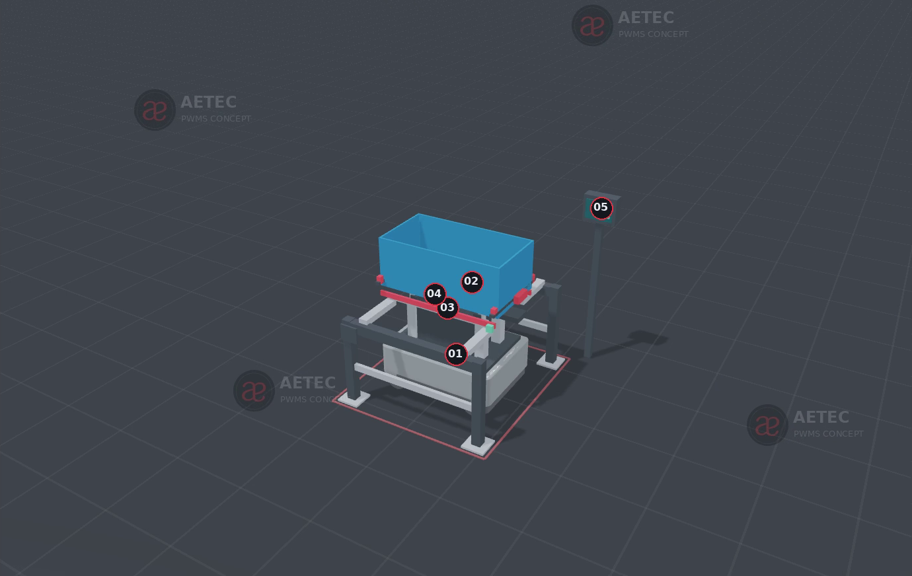
AETEC / PWMS MATERIAL FLOW
Five AMR handling methods
Add direct box lifting
between fixed docks
MiR250 enters below the box, jacks it up, carries it to the next dock and lowers it onto fixed rails.
Original four methods retained
Proposal · Interactive app · Video · Upload package
C05 | BOX MOVES; BOTH DOCK FRAMES STAY IN PLACE
PWMS Material Flow | AETEC | Rev 12 | 14 Sep 2026
01
Notes:
PWMS Option A B Technical Proposal Rev 10; PWMS 3D Practicality Review Rev 11; Transfer Studio articulated scene and C05 direct-box-design.json.
https://mobile-industrial-robots.com/products/robots/mir250
C05 is a new custom guided-lift concept for a qualified rigid-bottom box.
All rendered geometry and animation timing are concept studies, not certified equipment or guaranteed throughput.

Slide 2
FIVE METHOD COMPARISON
What moves and what the receiving station does
Method | Transported load | Receiving action
C01 MiR250 Hook | Existing trolley and raw part | Park and release trolley
C02 MC600 + UR30 | Six existing boxes on carriers | Transfer one carrier at a time
C03 MiR1200 Pallet Jack | Eight-box pallet cassette | Index and extract one box
C04 MiR250 lift carrier | Box and connected carrier | Set carrier down; roller transfer
C05 MiR250 box jack | One qualified rigid-bottom box | Lower onto fixed rails; exit
The handling method does not by itself define the factory fleet, machine-loading scope or ASRS.
PWMS Material Flow | AETEC | Rev 12 | 14 Sep 2026
02
Notes:
PWMS Option A B Technical Proposal Rev 10; PWMS 3D Practicality Review Rev 11; Transfer Studio articulated scene and C05 direct-box-design.json.
All rendered geometry and animation timing are concept studies, not certified equipment or guaranteed throughput.

Slide 3
ARCHITECTURE AND PROCESS BOUNDARY
Two material-flow architectures remain available
A REUSE TROLLEY AND EXISTING BOX
B QUALIFY ONE STANDARD CONTAINER
Raw part stays on its trolley. After qualified machining release, existing boxes support downstream handling.
A raw-compatible container follows the part through raw, WIP, HOLD and finished-goods stages.
C01 raw trolley route
C02 individual carrier handling
C03 eight-box batch movement
C05 simple box movement, if qualified
C04 transports a removable carrier
1,200 × 600 × 400 mm is provisional
Container and ASRS require joint design
Process access remains station-specific
Only Final Inspection PASS releases FG to ASRS. HOLD and rework stay segregated.
PWMS Material Flow | AETEC | Rev 12 | 14 Sep 2026
03
Notes:
PWMS Option A B Technical Proposal Rev 10; PWMS 3D Practicality Review Rev 11; Transfer Studio articulated scene and C05 direct-box-design.json.
All rendered geometry and animation timing are concept studies, not certified equipment or guaranteed throughput.

Slide 4
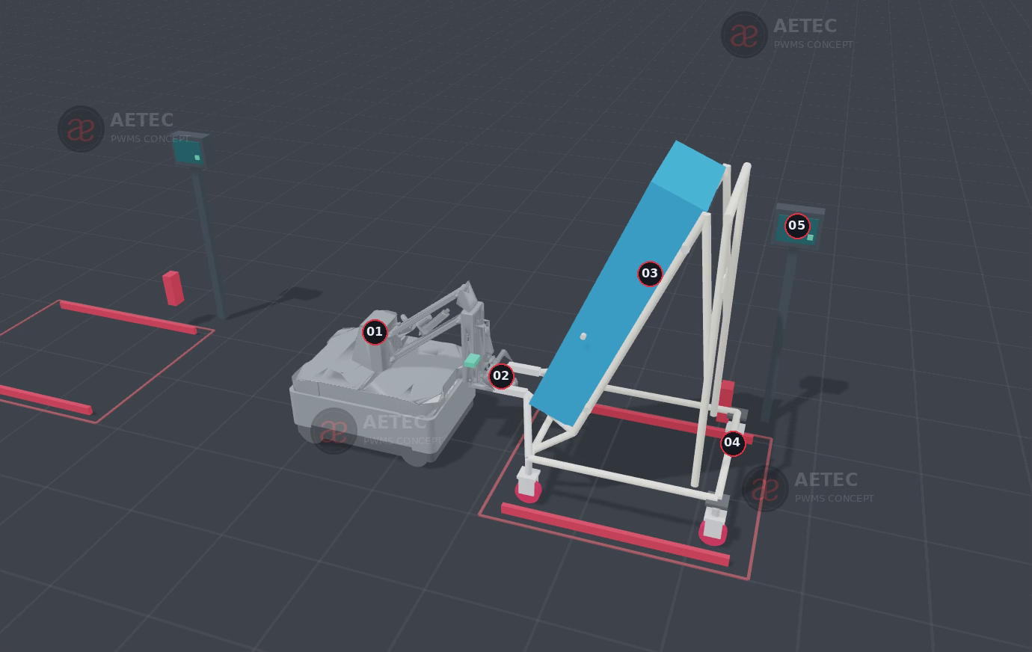
C01 / RAW MATERIAL MOVEMENT
MiR250 Hook reuses the existing trolley
CAPTURE AND VERIFY
Couple to an adapted capture bar; identify and confirm the trolley.
TOW AND PARK
Keep the larger forging in its inclined holder throughout transport.
COLLECT AND RETURN
Park at the station datum, release, then collect after process release.
Trolley rolling load, wheels, stability and route geometry require application confirmation.
PWMS Material Flow | AETEC | Rev 12 | 14 Sep 2026
04
Notes:
PWMS Option A B Technical Proposal Rev 10; PWMS 3D Practicality Review Rev 11; Transfer Studio articulated scene and C05 direct-box-design.json.
All rendered geometry and animation timing are concept studies, not certified equipment or guaranteed throughput.

Slide 5
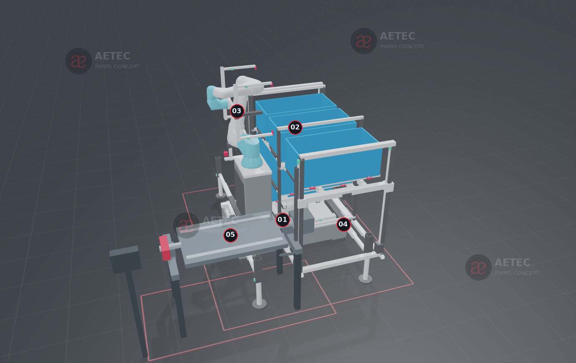
C02 / DOWNSTREAM BOX HANDLING
MC600 and UR30 provide six accessible box positions
SIX FIXED NESTS
Two side bays × three levels. Each carrier locks in its own position.
SHARED SIDE LIFTS
Extract the selected carrier and present it at a common arm height.
ONE BOX AT A TIME
Transfer to a flat table, locked tilt cradle or ASRS interface; return to its nest.
Rev 11 uses fixed nests and side presentation lifts, replacing the earlier six-drawer concept.
PWMS Material Flow | AETEC | Rev 12 | 14 Sep 2026
05
Notes:
PWMS Option A B Technical Proposal Rev 10; PWMS 3D Practicality Review Rev 11; Transfer Studio articulated scene and C05 direct-box-design.json.
All rendered geometry and animation timing are concept studies, not certified equipment or guaranteed throughput.

Slide 6
C02 / PAYLOAD AND GEOMETRY
The tool and complete loaded carrier count in payload
Planning item | Value | Meaning
UR30 normal payload | 30 kg | Extended mode not assumed
Positive tool assembly | 12 kg | Current tool allowance
Loaded carrier ceiling | 18 kg | 30 kg minus 12 kg tool
Loaded carrier target | ≤16 kg | Preferred working allowance
Box + carrier | 4 kg + 3 kg | Measure production items
Part mass screen | 11 kg ceiling / 9 kg target | Before load-centre and dynamics approval
Travel envelope ≈1.86 × 1.34 × 2.10 m | Deployed span ≈2.45 m before protective clearance.
PWMS Material Flow | AETEC | Rev 12 | 14 Sep 2026
06
Notes:
PWMS Option A B Technical Proposal Rev 10; PWMS 3D Practicality Review Rev 11; Transfer Studio articulated scene and C05 direct-box-design.json.
https://www.universal-robots.com/products/ur30-1300/
https://www.enabled-robotics.com/mobilecobots
Mass screen: 6 × 18 + 170 kg mechanism + 12 kg tool = 290 kg additional transport load; reconcile scope against vendor 380 kg package figure.
All rendered geometry and animation timing are concept studies, not certified equipment or guaranteed throughput.

Slide 7
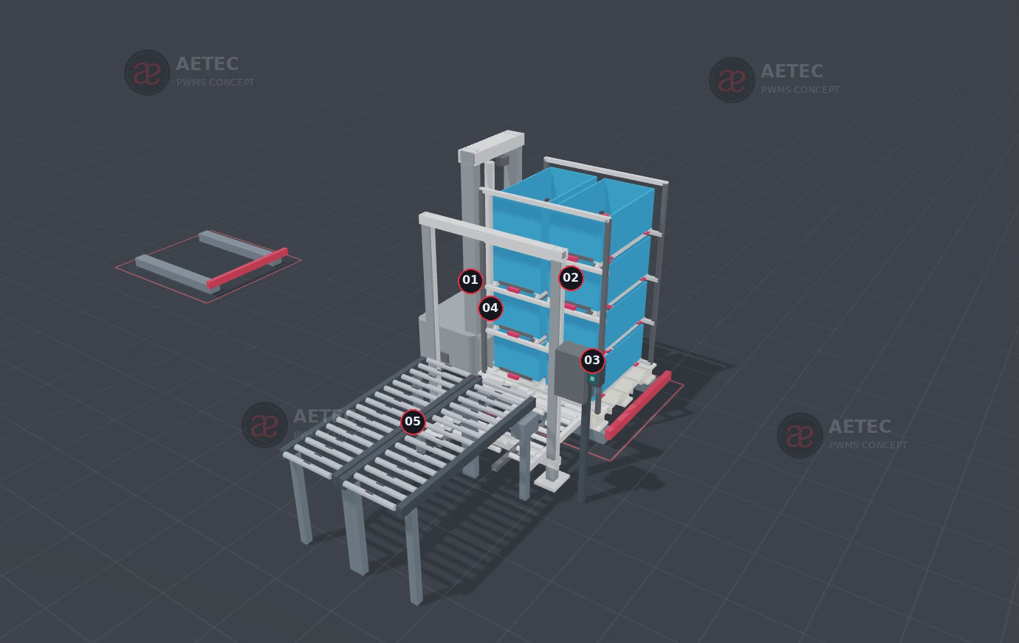
C03 / PALLET CASSETTE AND ASRS EXTRACTION
MiR1200 Pallet Jack moves an eight-box batch
TWO BY FOUR
Eight existing boxes on a 1,200 × 1,000 mm pallet cassette.
RAISED PALLET DOCK
100 mm supports provide the illustrated fork-entry clearance.
INDEX AND EXTRACT
A separate lift transfers one identified box to the 830 mm ASRS plane.
Eight boxes supersede the earlier ten-box concept. The complete pallet stays outside the tote ASRS.
PWMS Material Flow | AETEC | Rev 12 | 14 Sep 2026
07
Notes:
PWMS Option A B Technical Proposal Rev 10; PWMS 3D Practicality Review Rev 11; Transfer Studio articulated scene and C05 direct-box-design.json.
All rendered geometry and animation timing are concept studies, not certified equipment or guaranteed throughput.

Slide 8
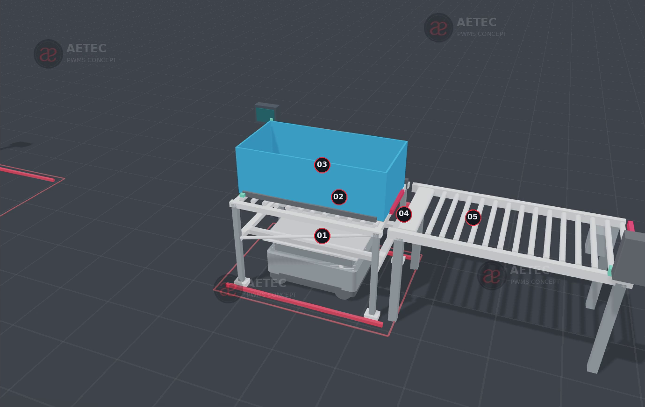
C04 / STANDARD CONTAINER OPTION
MiR250 transports a connected removable carrier
LIFT THE CARRIER
The carrier and box travel together; all load counts in the application budget.
LEAVE ON ITS FEET
Lower onto the dock and prove the lock, power and control interface.
ROLLER HANDOFF
Transfer the box over a supported bridge at the 830 mm receiving plane.
60 mm lift stroke = 30 mm to contact + 30 mm ground clearance. Standard box size remains provisional.
PWMS Material Flow | AETEC | Rev 12 | 14 Sep 2026
08
Notes:
PWMS Option A B Technical Proposal Rev 10; PWMS 3D Practicality Review Rev 11; Transfer Studio articulated scene and C05 direct-box-design.json.
All rendered geometry and animation timing are concept studies, not certified equipment or guaranteed throughput.

Slide 9
C05 / NEW DIRECT BOX LIFT
MiR250 jacks the box up from a fixed station
ENTER BELOW THE BOX
The lowered pad passes between the fixed support rails.
LIFT AND RETAIN
The guided, braked pad lifts the box; positive retainers secure transport.
LOWER AND LEAVE
Set down on the next fixed dock, lower the pad and drive out.
Both docking frames stay in place. Only a box with a qualified rigid bottom transfers directly.
PWMS Material Flow | AETEC | Rev 12 | 14 Sep 2026
09
Notes:
PWMS Option A B Technical Proposal Rev 10; PWMS 3D Practicality Review Rev 11; Transfer Studio articulated scene and C05 direct-box-design.json.
All rendered geometry and animation timing are concept studies, not certified equipment or guaranteed throughput.

Slide 10
C05 / NOMINAL GEOMETRY
C05 uses a custom guided lift and fixed support rails
Interface | Illustrated value | Design meaning
Box envelope | 840 × 450 × 330 mm | Qualify the rigid bottom and bearing areas
Dock support plane | 650 mm | Both stations use the same nominal datum
Pad low / high | 610 / 710 mm | 100 mm total stroke
Contact / clearance | 40 / 60 mm | Contact box, then clear fixed supports
Pad / rail opening | 330 / 375 mm | 22.5 mm nominal clearance on each side
Dock centres | 4,000 mm apart | Demonstration layout only
Custom application: the standard Shelf Carrier attachment is not assumed to provide this mechanism.
PWMS Material Flow | AETEC | Rev 12 | 14 Sep 2026
10
Notes:
PWMS Option A B Technical Proposal Rev 10; PWMS 3D Practicality Review Rev 11; Transfer Studio articulated scene and C05 direct-box-design.json.
https://mobile-industrial-robots.com/products/robots/mir250
https://mobile-industrial-robots.com/products/applications/mir-shelf-carrier-250
980 mm leg gap is mechanical geometry, not an approved protective-field corridor.
All rendered geometry and animation timing are concept studies, not certified equipment or guaranteed throughput.

Slide 11
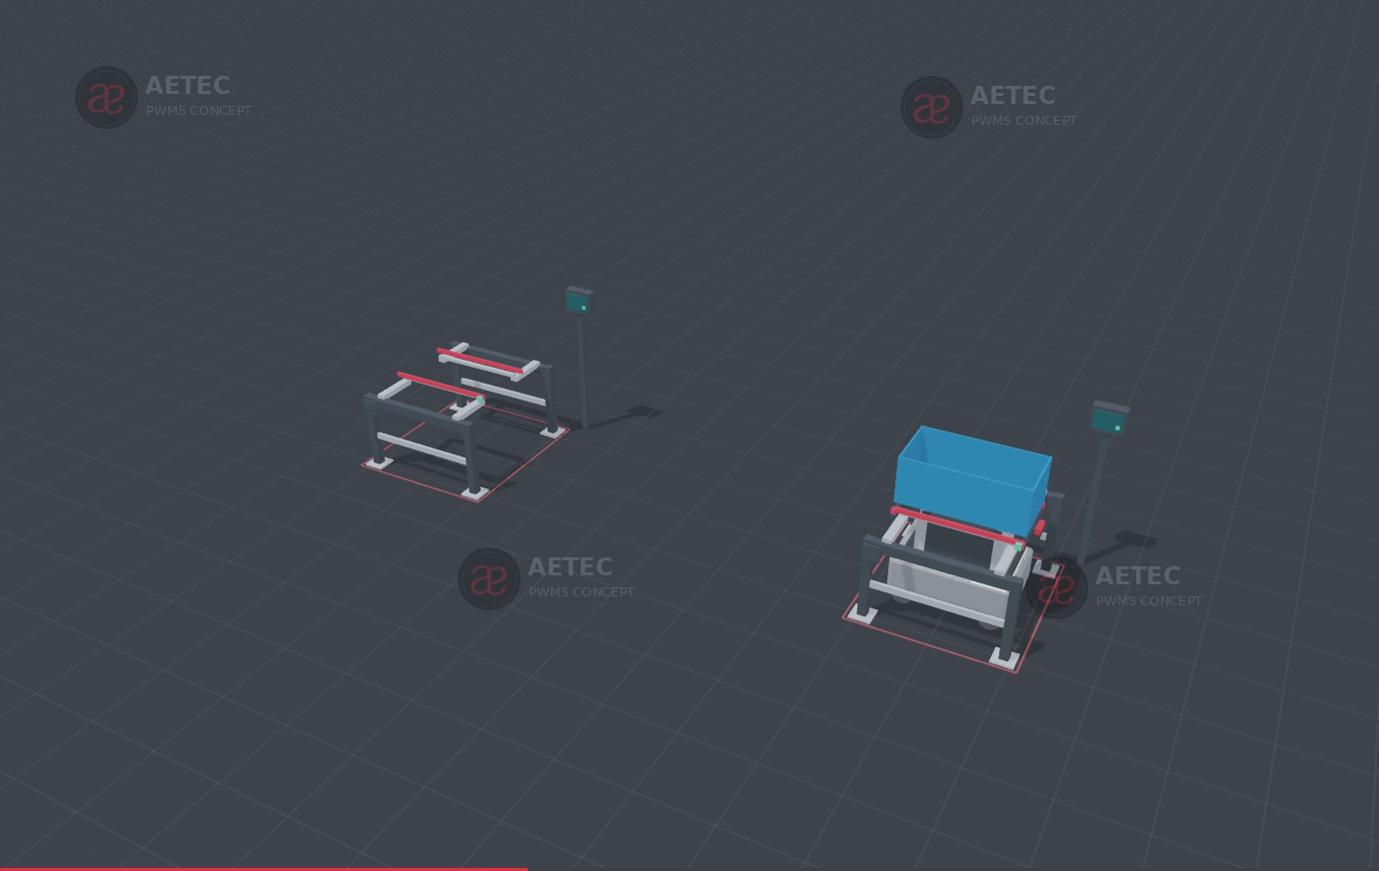
C05 / DOCK TO DOCK SEQUENCE
The complete C05 cycle includes setdown and return
01
Reserve and identify source / destination
02
Enter lowered; contact and lift
03
Prove retention; carry the box
04
Lower onto the next fixed dock
05
Release, lower pad and exit
06
Collect after release and return
The model uses 21 detailed steps. Animation timing is illustrative and does not establish cycle-time performance.
PWMS Material Flow | AETEC | Rev 12 | 14 Sep 2026
11
Notes:
PWMS Option A B Technical Proposal Rev 10; PWMS 3D Practicality Review Rev 11; Transfer Studio articulated scene and C05 direct-box-design.json.
All rendered geometry and animation timing are concept studies, not certified equipment or guaranteed throughput.

Slide 12
C04 AND C05 / PRACTICAL DIFFERENCE
Choose the MiR250 method by the required handoff
Decision factor | C04 removable carrier | C05 direct box jack
What travels | Box and structural carrier | Box only
What stays at station | Carrier after setdown; receiving dock | Both fixed docking frames
Receiving operation | Powered roller box transfer | Supported box setdown
Illustrated load envelope | 1,200 × 600 × 400 mm provisional | 840 × 450 × 330 mm qualified box
Main custom hardware | Carrier, lift, lock and roller interface | Guided lift, retainers and support rails
ASRS connection | Engineered transfer interface shown | Separate transfer interface required
Select C05 for a defined station-to-station box movement when fixed support rails satisfy the receiving task.
PWMS Material Flow | AETEC | Rev 12 | 14 Sep 2026
12
Notes:
PWMS Option A B Technical Proposal Rev 10; PWMS 3D Practicality Review Rev 11; Transfer Studio articulated scene and C05 direct-box-design.json.
All rendered geometry and animation timing are concept studies, not certified equipment or guaranteed throughput.

Slide 13
17 PRODUCTION STATIONS
Plan the station schedule before choosing the fleet
Planning element | Retained basis | Implication
Production stations | 17 | Map each exact machine and process route
Positions per station | 2 to 6 or more | 34 to 102 production docking positions
Additional functions | Incoming, outgoing, charger, ASRS | Add separate positions and buffers
Operating states | PASS, HOLD, rework, empty return | Reserve and identify exception locations
Fleet sizing | Demand × transfers × rework factor | Measure actual route, dwell and handling time
Batch capacity reduces mission count only when useful batches are available. Every box still needs handling.
PWMS Material Flow | AETEC | Rev 12 | 14 Sep 2026
13
Notes:
PWMS Option A B Technical Proposal Rev 10; PWMS 3D Practicality Review Rev 11; Transfer Studio articulated scene and C05 direct-box-design.json.
All rendered geometry and animation timing are concept studies, not certified equipment or guaranteed throughput.

Slide 14
DATA AND CONTROL OWNERSHIP
Traceability connects the part to its actual movement
Layer | Required record or authority
Part and process | Serial / batch, traveller, router revision and release state
Movement | Box / carrier / trolley ID, AMR mission, station and timestamps
Work and quality | Machine, fixture, operator, PASS / HOLD / rework and approval
Storage | ASRS location, entry / exit and inventory reconciliation
Equipment control | MiR Fleet, WCS and station PLCs retain physical motion authority
Business integration | Aetec platform exchanges approved states with MES / WMS / QMS
The web app demonstrates and plans the concept. It is not a safety PLC or production machine controller.
PWMS Material Flow | AETEC | Rev 12 | 14 Sep 2026
14
Notes:
PWMS Option A B Technical Proposal Rev 10; PWMS 3D Practicality Review Rev 11; Transfer Studio articulated scene and C05 direct-box-design.json.
All rendered geometry and animation timing are concept studies, not certified equipment or guaranteed throughput.

Slide 15
FINISHED GOODS STORAGE
ASRS compatibility depends on the qualified container
Storage basis | Retained value | Qualification
Six-metre concept | 1,008 physical / 1,000 enabled locations | 4 faces × 21 bays × 12 levels
Working occupancy | Approximately 850–900 stored units | At 85–90% working occupancy
Earlier FG box | 980 × 640 × 320 mm | Prior storage planning basis
Current existing box | 840 × 450 × 330 mm | Recheck the 330 mm height
Standard-container option | 1,200 × 600 × 400 mm provisional | Requires a separate storage design
Pallet and carrier | Remain outside tote storage | Transfer individual compatible boxes
Only released FG enters the FG-ASRS. A changed box size does not automatically approve rack fit or lower cost.
PWMS Material Flow | AETEC | Rev 12 | 14 Sep 2026
15
Notes:
PWMS Option A B Technical Proposal Rev 10; PWMS 3D Practicality Review Rev 11; Transfer Studio articulated scene and C05 direct-box-design.json.
All rendered geometry and animation timing are concept studies, not certified equipment or guaranteed throughput.

Slide 16
COMMERCIAL BASELINES / SGD EXCLUDING GST
Retained ROM values have different scope boundaries
Package | Retained selling ROM | Scope boundary
Hook 1A / six-Hook 1B | S$603,900 / S$1,168,200 | Complete route; initial 20-trolley batch
FG-ASRS base | S$1,580,000 | Upstream transfer separate
FG-ASRS + mobile / fixed transfer | S$1,770,000 / S$1,890,000 | Alternative upstream interfaces
Common platform + lift / Shelf Lift fleet | S$3,000,000 / S$2,960,200 | Alternative common-container architecture
MC600 + UR30 add-on | S$420,000 historical ROM | Reconcile the revised side-lift scope
C05 two-dock pilot | S$194,400 new engineering ROM | One AMR, two docks, one defined route
Do not add 10% again to selling ROM. Apply the retained markup agreement only to fresh supplier buy costs.
PWMS Material Flow | AETEC | Rev 12 | 14 Sep 2026
16
Notes:
PWMS Option A B Technical Proposal Rev 10; PWMS 3D Practicality Review Rev 11; Transfer Studio articulated scene and C05 direct-box-design.json.
PWMS End to End ASRS AMR Options Budgetary Quotation Rev 6 (5 September 2026); retained 10% buy-cost hardware markup in Rev 10. C05 D01-D08 are explicitly engineering allowances, not supplier quotations.
All rendered geometry and animation timing are concept studies, not certified equipment or guaranteed throughput.

Slide 17
NEW ENGINEERING ROM / SGD EXCLUDING GST
C05 has a separate two-dock pilot allowance
Pilot allowance | Amount | Basis
MiR250 base and delivered hardware | S$95,000 | Historical project allowance anchor
Charger | S$8,400 | Historical project allowance anchor
Guided jack module and box restraint | S$36,000 | New engineering allowance
Two fixed docks | S$17,000 | 2 × S$8,500 engineering allowance
Local controls and mission setup | S$20,000 | Defined two-station pilot scope
Route, FAT, SAT and training | S$18,000 | Pilot implementation allowance
Total | S$194,400 | Planning sensitivity ±30%: S$136,080–252,720
Engineering ROM. Full factory rollout, ASRS and machine loading are separate scope.
PWMS Material Flow | AETEC | Rev 12 | 14 Sep 2026
17
Notes:
PWMS Option A B Technical Proposal Rev 10; PWMS 3D Practicality Review Rev 11; Transfer Studio articulated scene and C05 direct-box-design.json.
PWMS End to End ASRS AMR Options Budgetary Quotation Rev 6 (5 September 2026); retained 10% buy-cost hardware markup in Rev 10. C05 D01-D08 are explicitly engineering allowances, not supplier quotations.
All rendered geometry and animation timing are concept studies, not certified equipment or guaranteed throughput.

Slide 18
PILOT AND HANDOVER
Freeze one receiving task and prove the complete cycle
1 CONFIRM THE LOAD
2 CONFIRM THE ROUTE
3 PROVE THE INTERFACE
Measure envelope, gross mass, centre of gravity, box support and retention requirements.
Define source and destination docks, service height, buffers, floor and operating exceptions.
Agree supplier acceptance, FAT and SAT criteria before production rollout.
Delivered with this revision
Five-method presentation and consolidated technical proposal
Interactive Transfer Studio and Cloudflare upload ZIP
Full five-chapter video and separate MiR250 box jack clip
Budgetary supplement and continuation record
29 deterministic scene configurations checked; C05 nominal entry geometry checked separately.
PWMS Material Flow | AETEC | Rev 12 | 14 Sep 2026
18
Notes:
PWMS Option A B Technical Proposal Rev 10; PWMS 3D Practicality Review Rev 11; Transfer Studio articulated scene and C05 direct-box-design.json.
Scene tests cover defined support ownership, return continuity and selected interlocks. C05 sweep checks 69 nominal positions in empty and loaded states; it is not a complete application safety certification.
All rendered geometry and animation timing are concept studies, not certified equipment or guaranteed throughput.

